Slide 1
PREOPERATIVE MEDICAL EVALUATION FOR NON-CARDIAC SURGERY
PREPARED BY
DR.ZAINULABEDEEN

Slide 2
OBJECTIVES
To assess perioperative cardiac risk using clinical risk factors and type of surgical procedures
To describe a stepwise approach for preoperative cardiac risk assessment.
To simplify medical clearance for practitionals
To describe how to reduce cardiac risk

Slide 3
Main points for Evaluation of perioperative risk
Specific risk factors
Type of surgery
Functional capacity of the patient

Slide 4
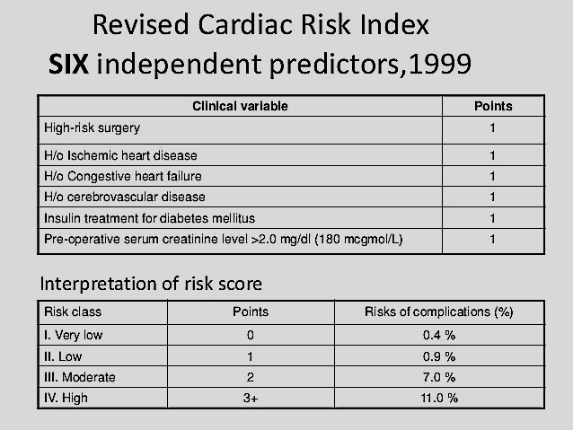
Revised cardiac risk index
Six independent predictors ,1999
Interpretation of risk score

Slide 5
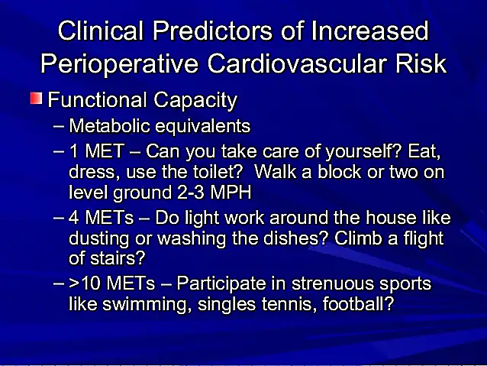
Clinical Predictors of increased
Perioperative Cardiovascular Risk

Slide 6
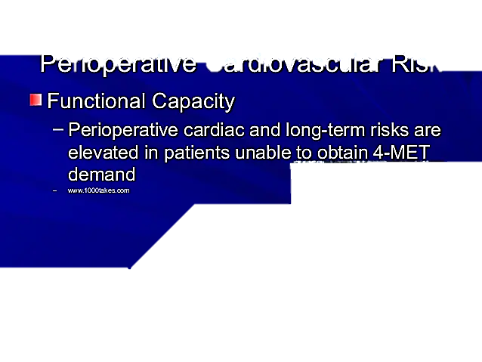
Clinical Predictors of increased
Perioperative Cardiovascular Risk

Slide 7
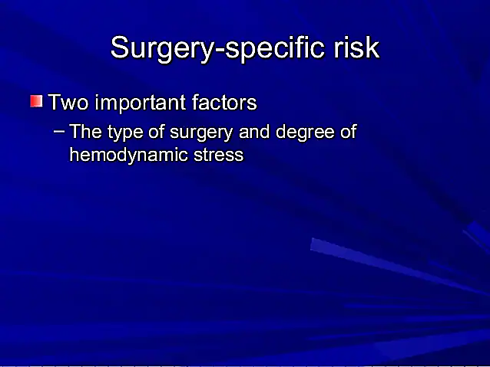
Surgery – specific Risk

Slide 8
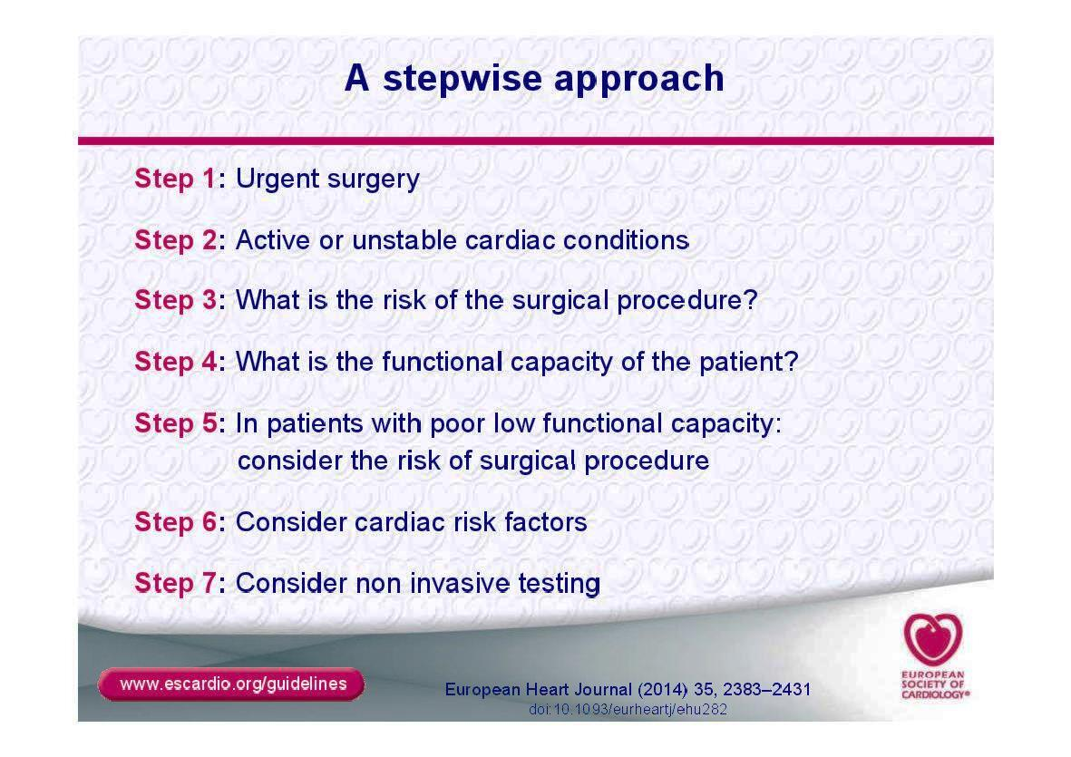
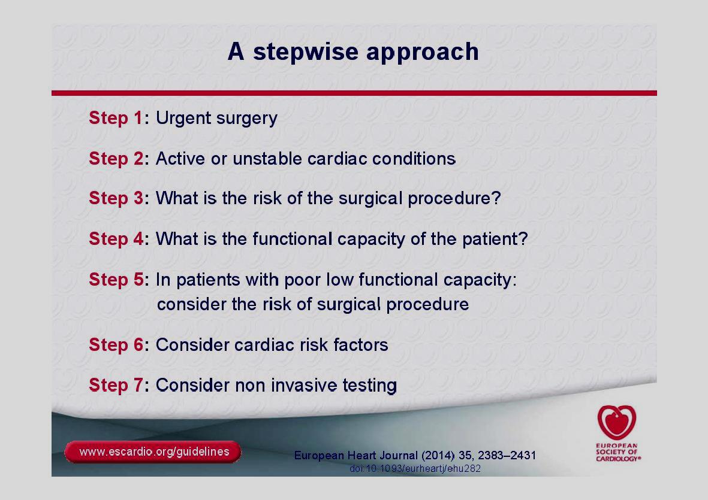
A stepwise approach

Slide 9
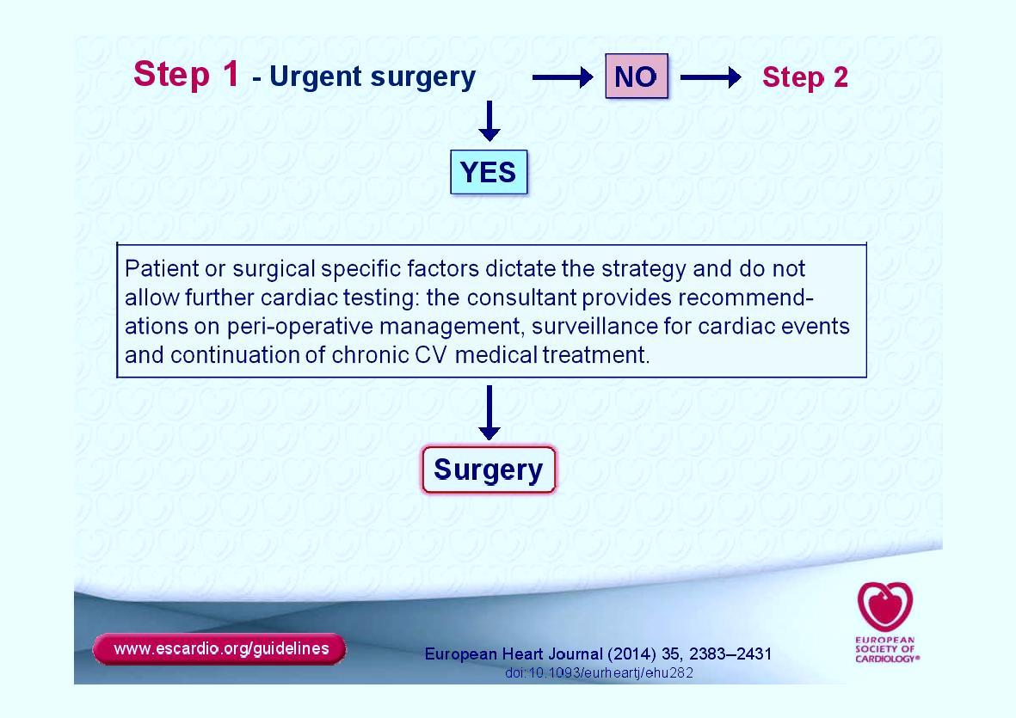

Slide 10
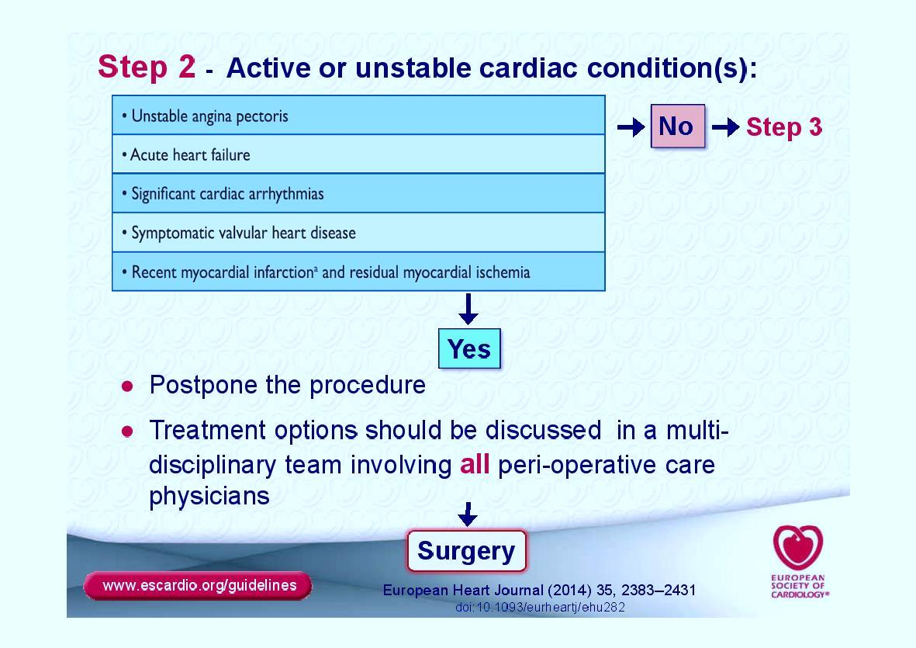
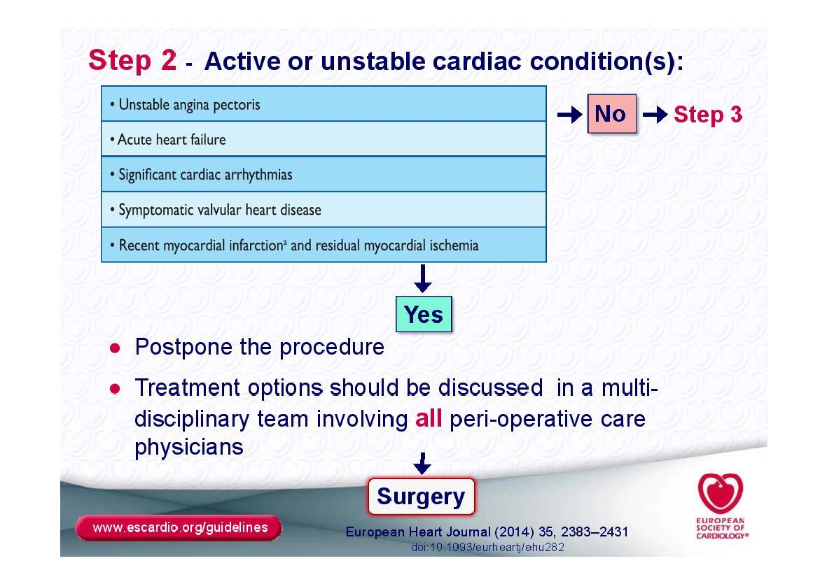

Slide 11
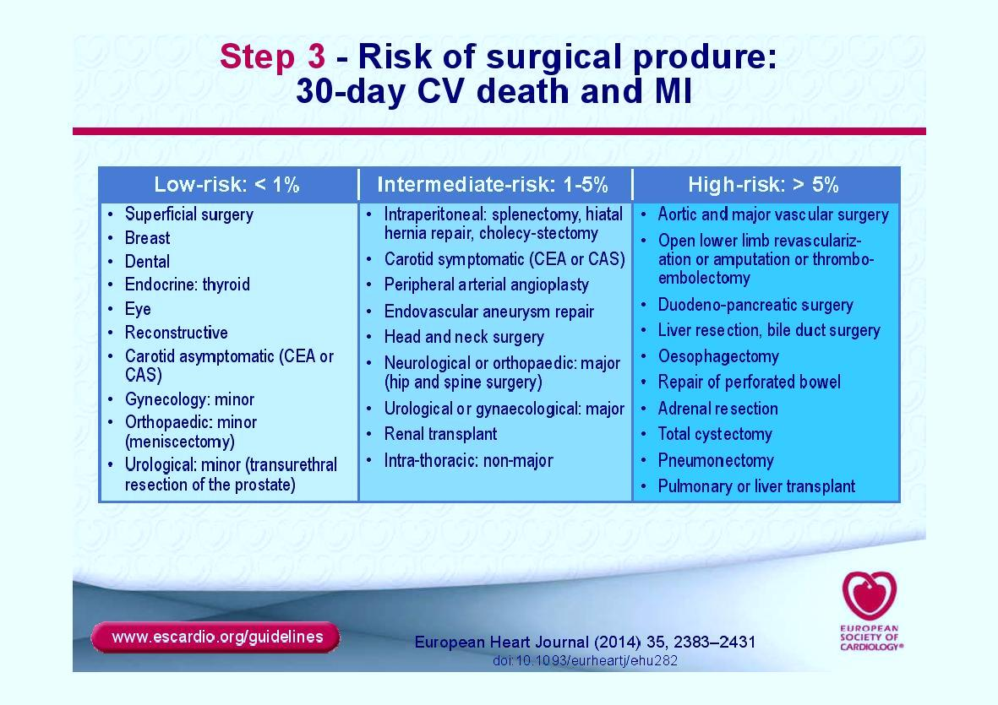
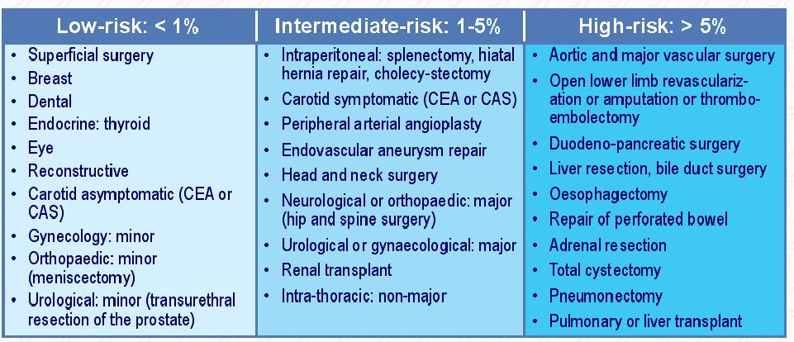

Slide 12
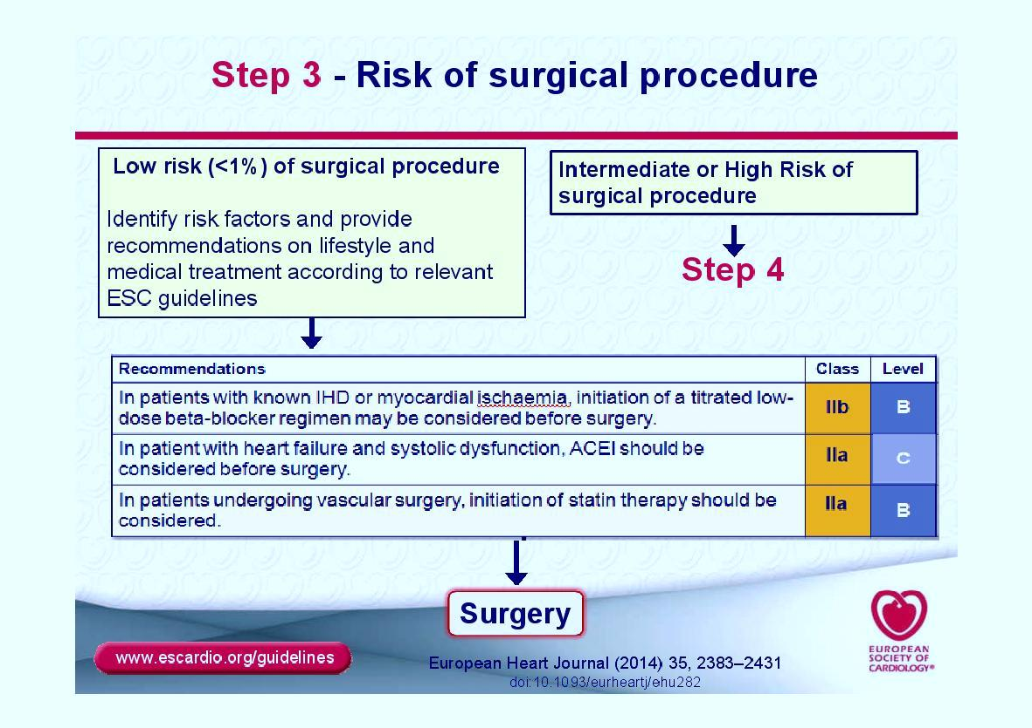

Slide 13
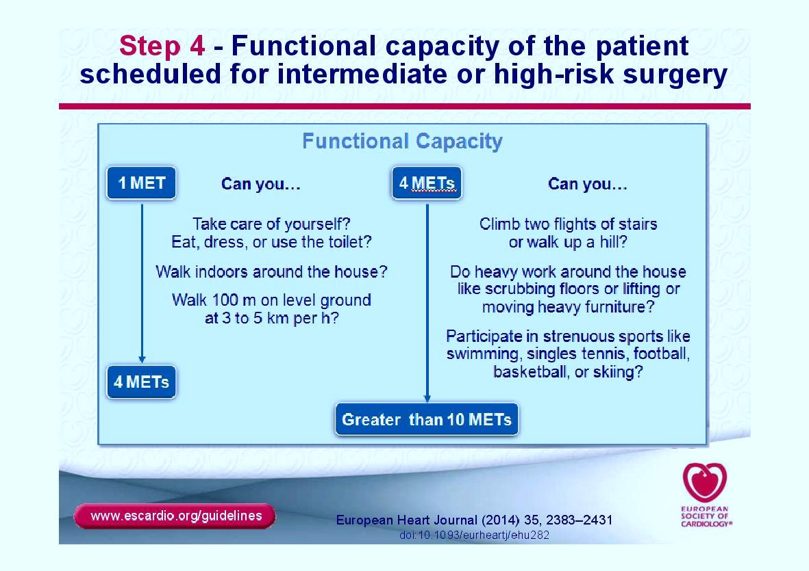
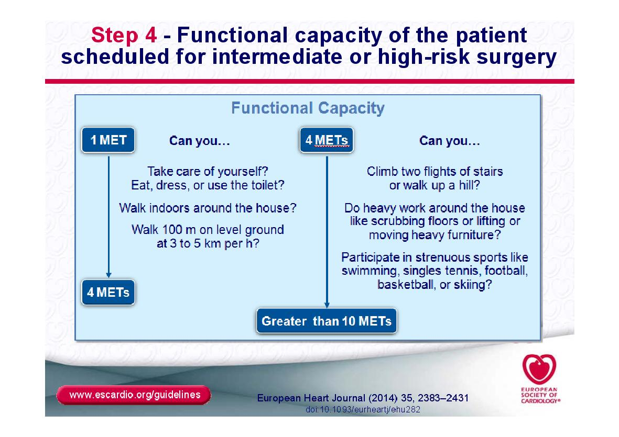

Slide 14
Duke Activity Status Index
Activity | Weight
Can you…
1. take care of yourself, that is, eating, dressing, bathing, or using the toilet? | 2.75
2. walk indoors, such as around your house? | 1.75
3. walk a block or 2 on level ground? | 2.75
4. climb a flight of stairs or walk up a hill? | 5.50
5. run a short distance? | 8.00
6. do light work around the house like dusting or washing dishes? | 2.70
7. do moderate work around the house like vacuuming, sweeping floors, or carrying in groceries? | 3.50
8. do heavy work around the house like scrubbing floors or lifting or moving heavy furniture? | 8.00
9. do yardwork like raking leaves, weeding, or pushing a power mower? | 4.50
10. have sexual relations? | 5.25
11. participate in moderate recreational activities like golf, bowling, dancing, doubles tennis, or throwing a baseball or football? | 6.00
12. participate in strenuous sports like swimming, singles tennis, football, basketball, or skiing? | 7.50
Reproduced with permission from Hlatky et al.

Slide 15
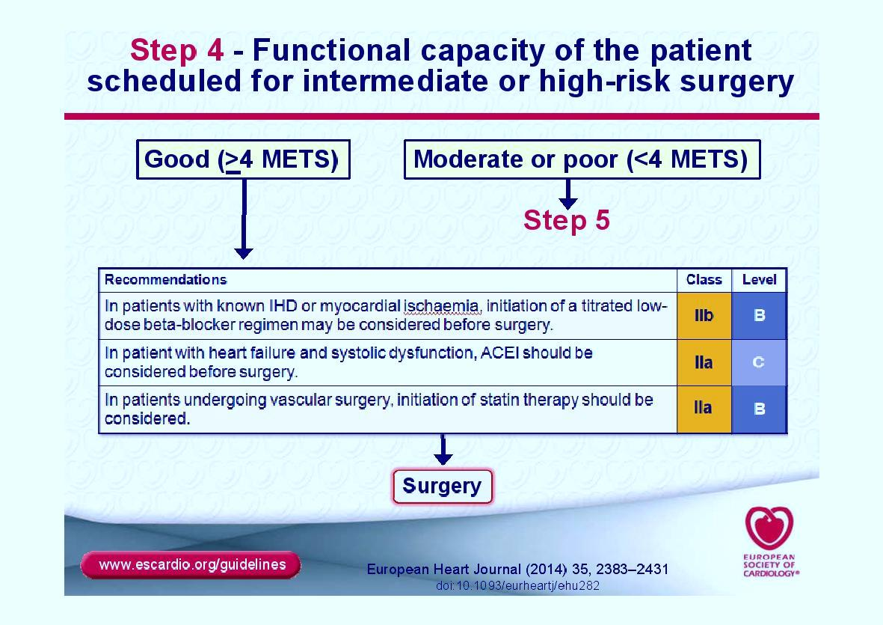
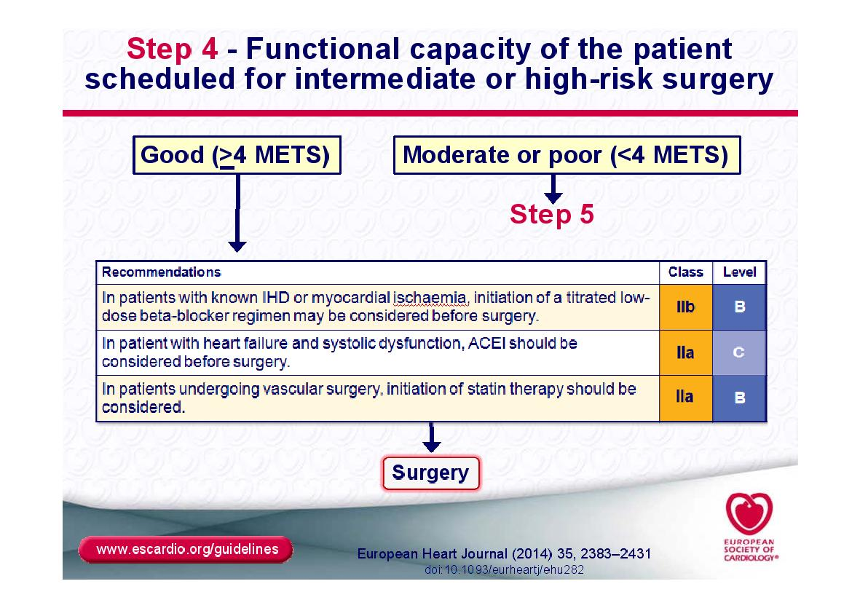

Slide 16
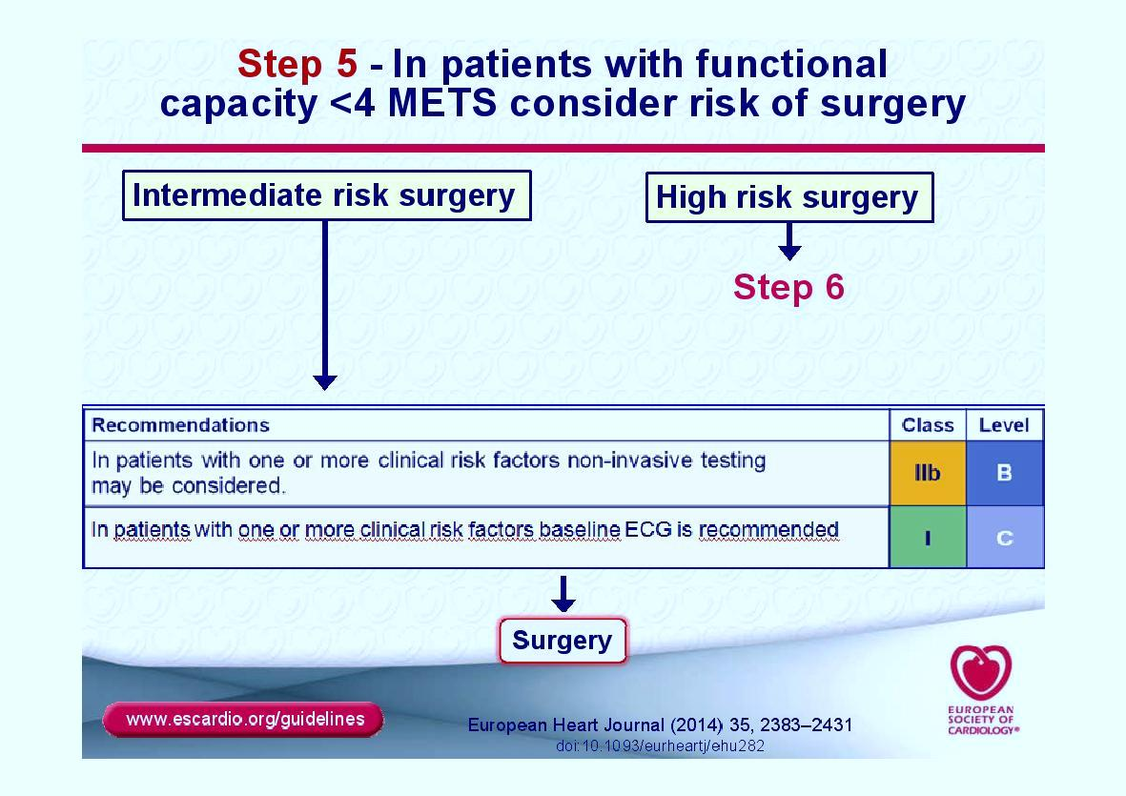
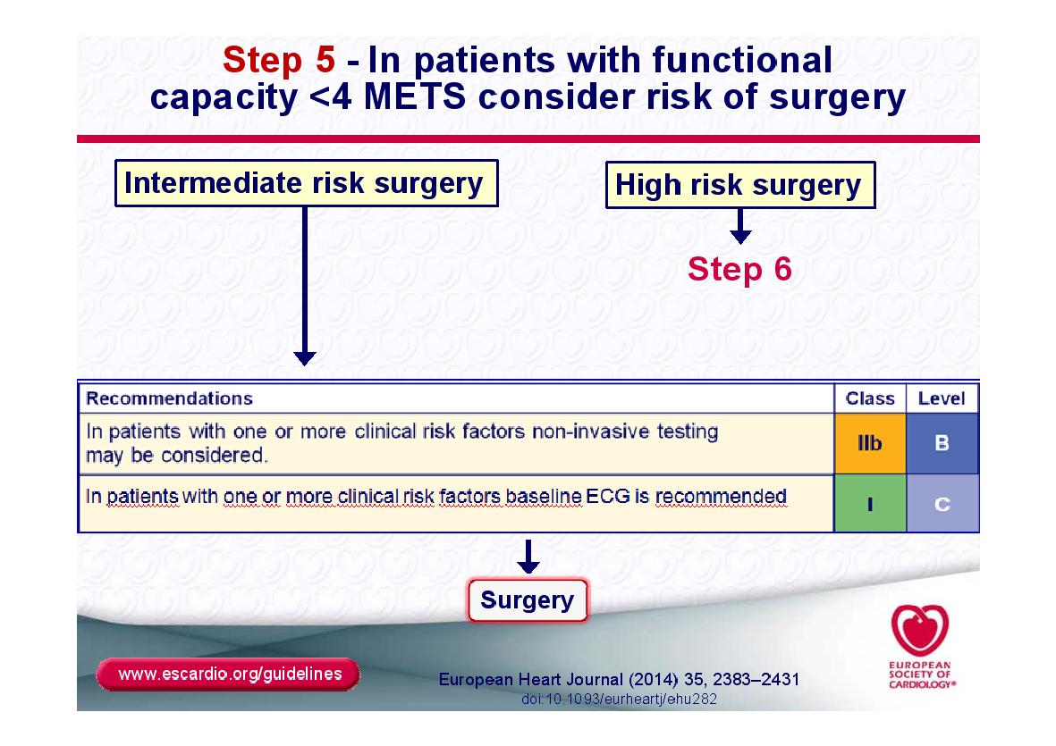

Slide 17
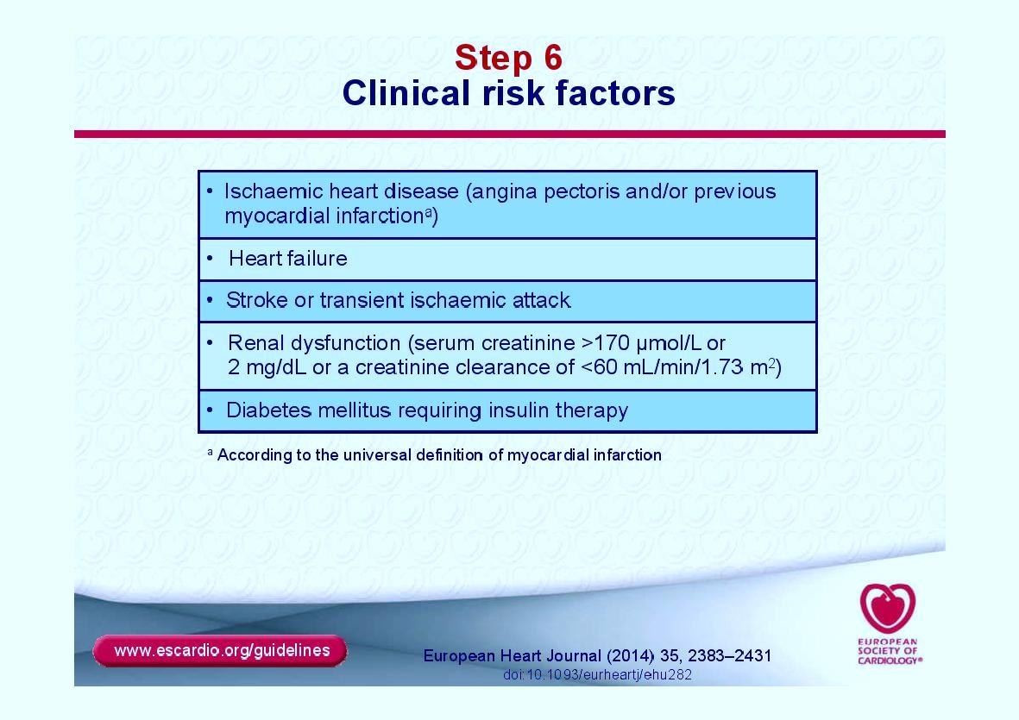
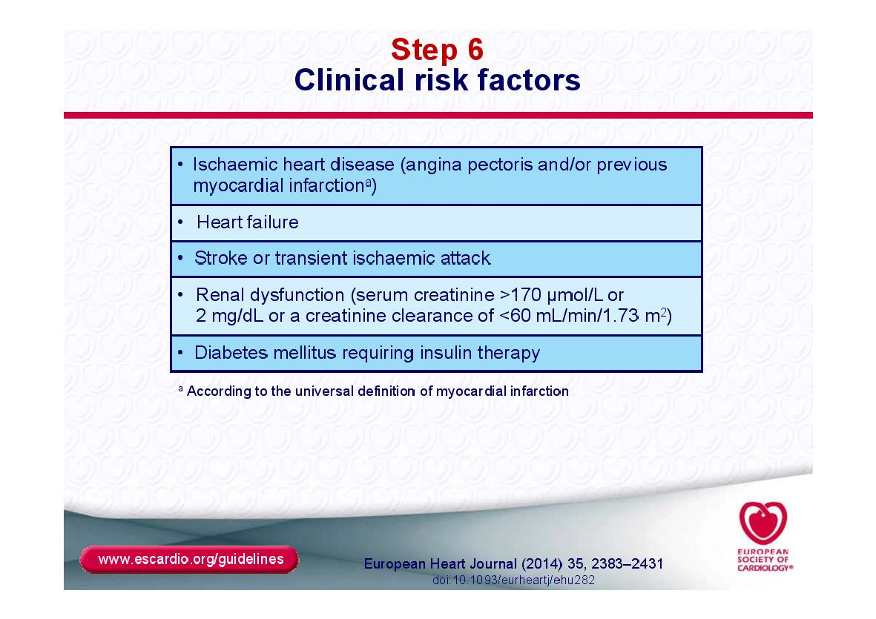

Slide 18
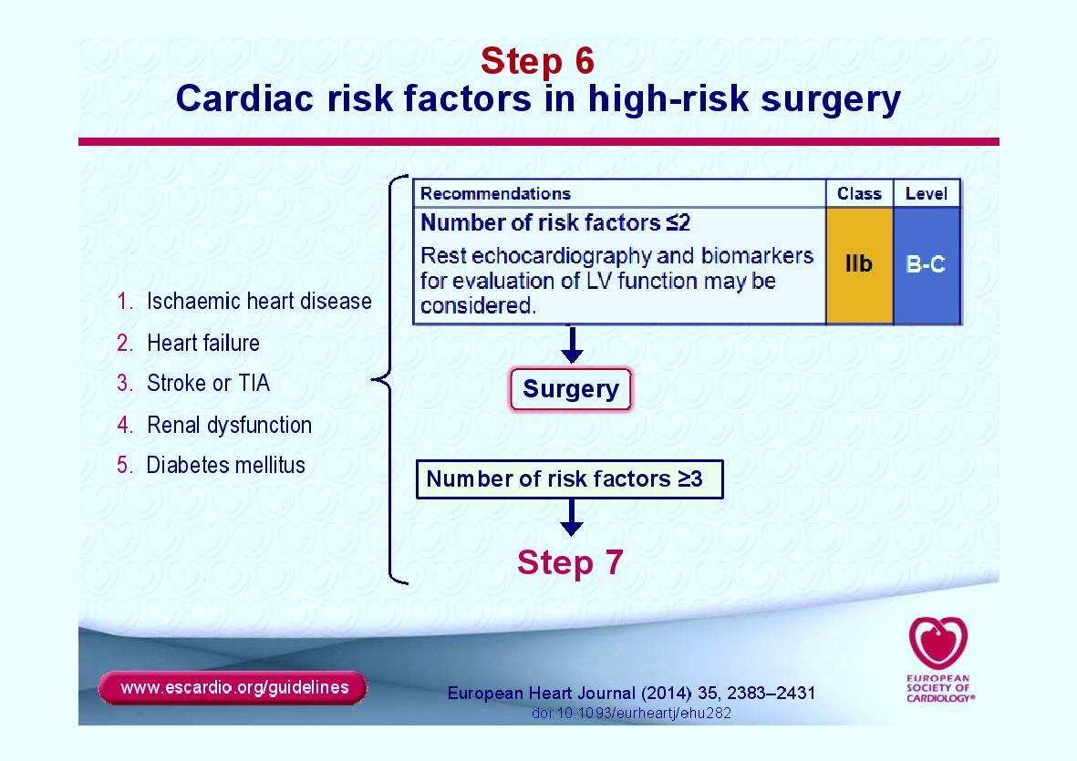

Slide 19
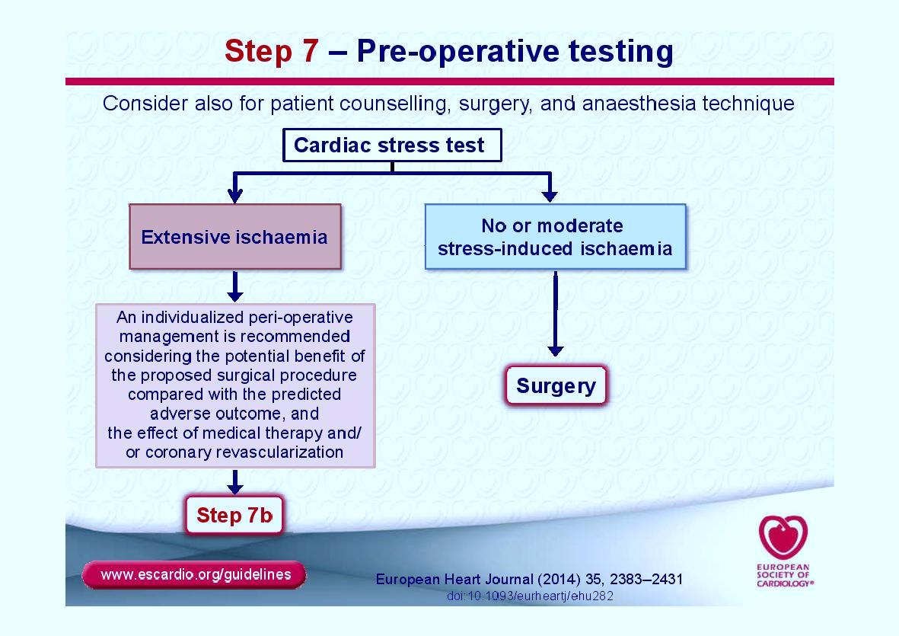
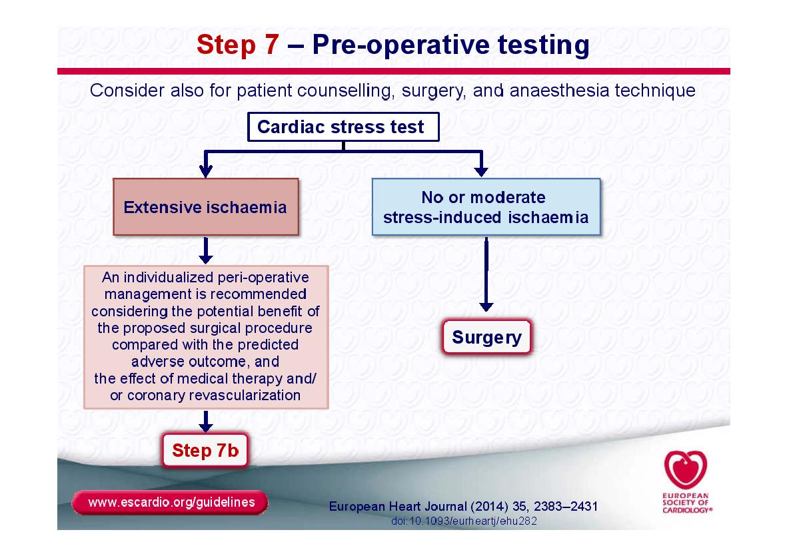

Slide 20
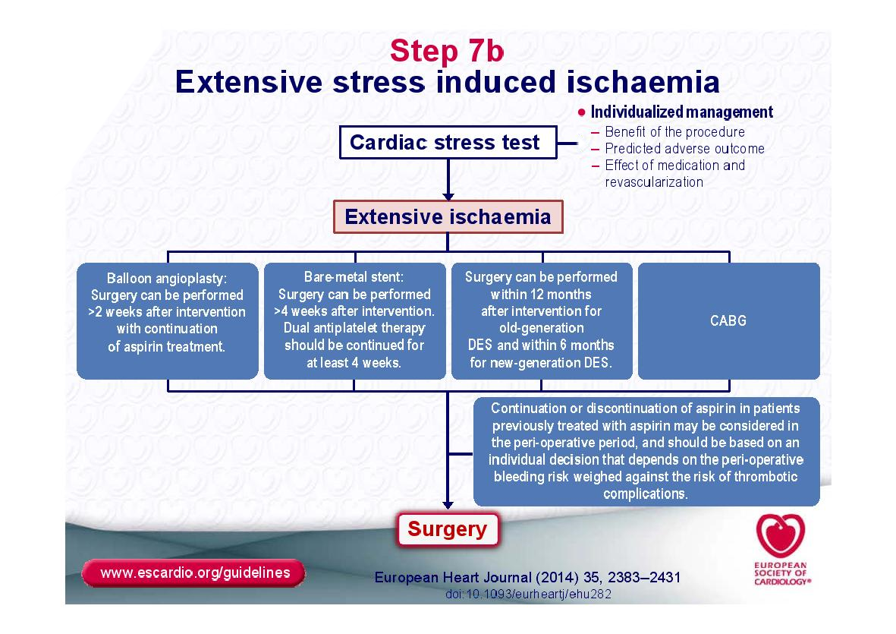

Slide 21
Pre-operative Tests

Slide 22
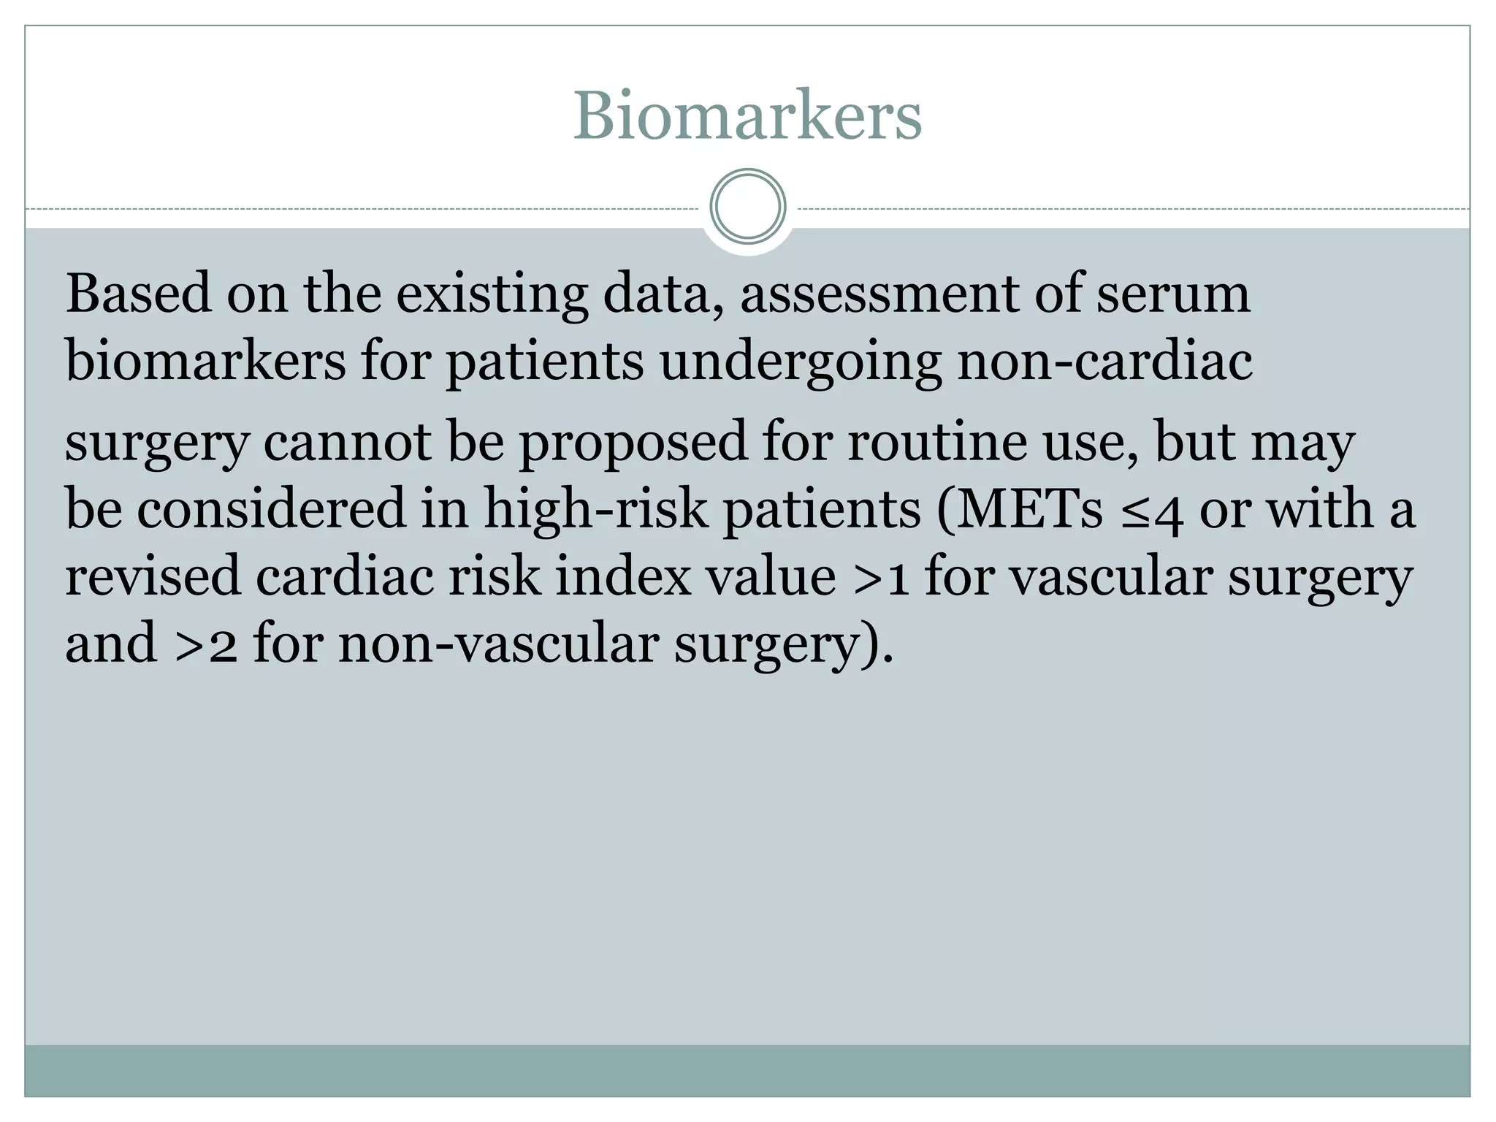

Slide 43
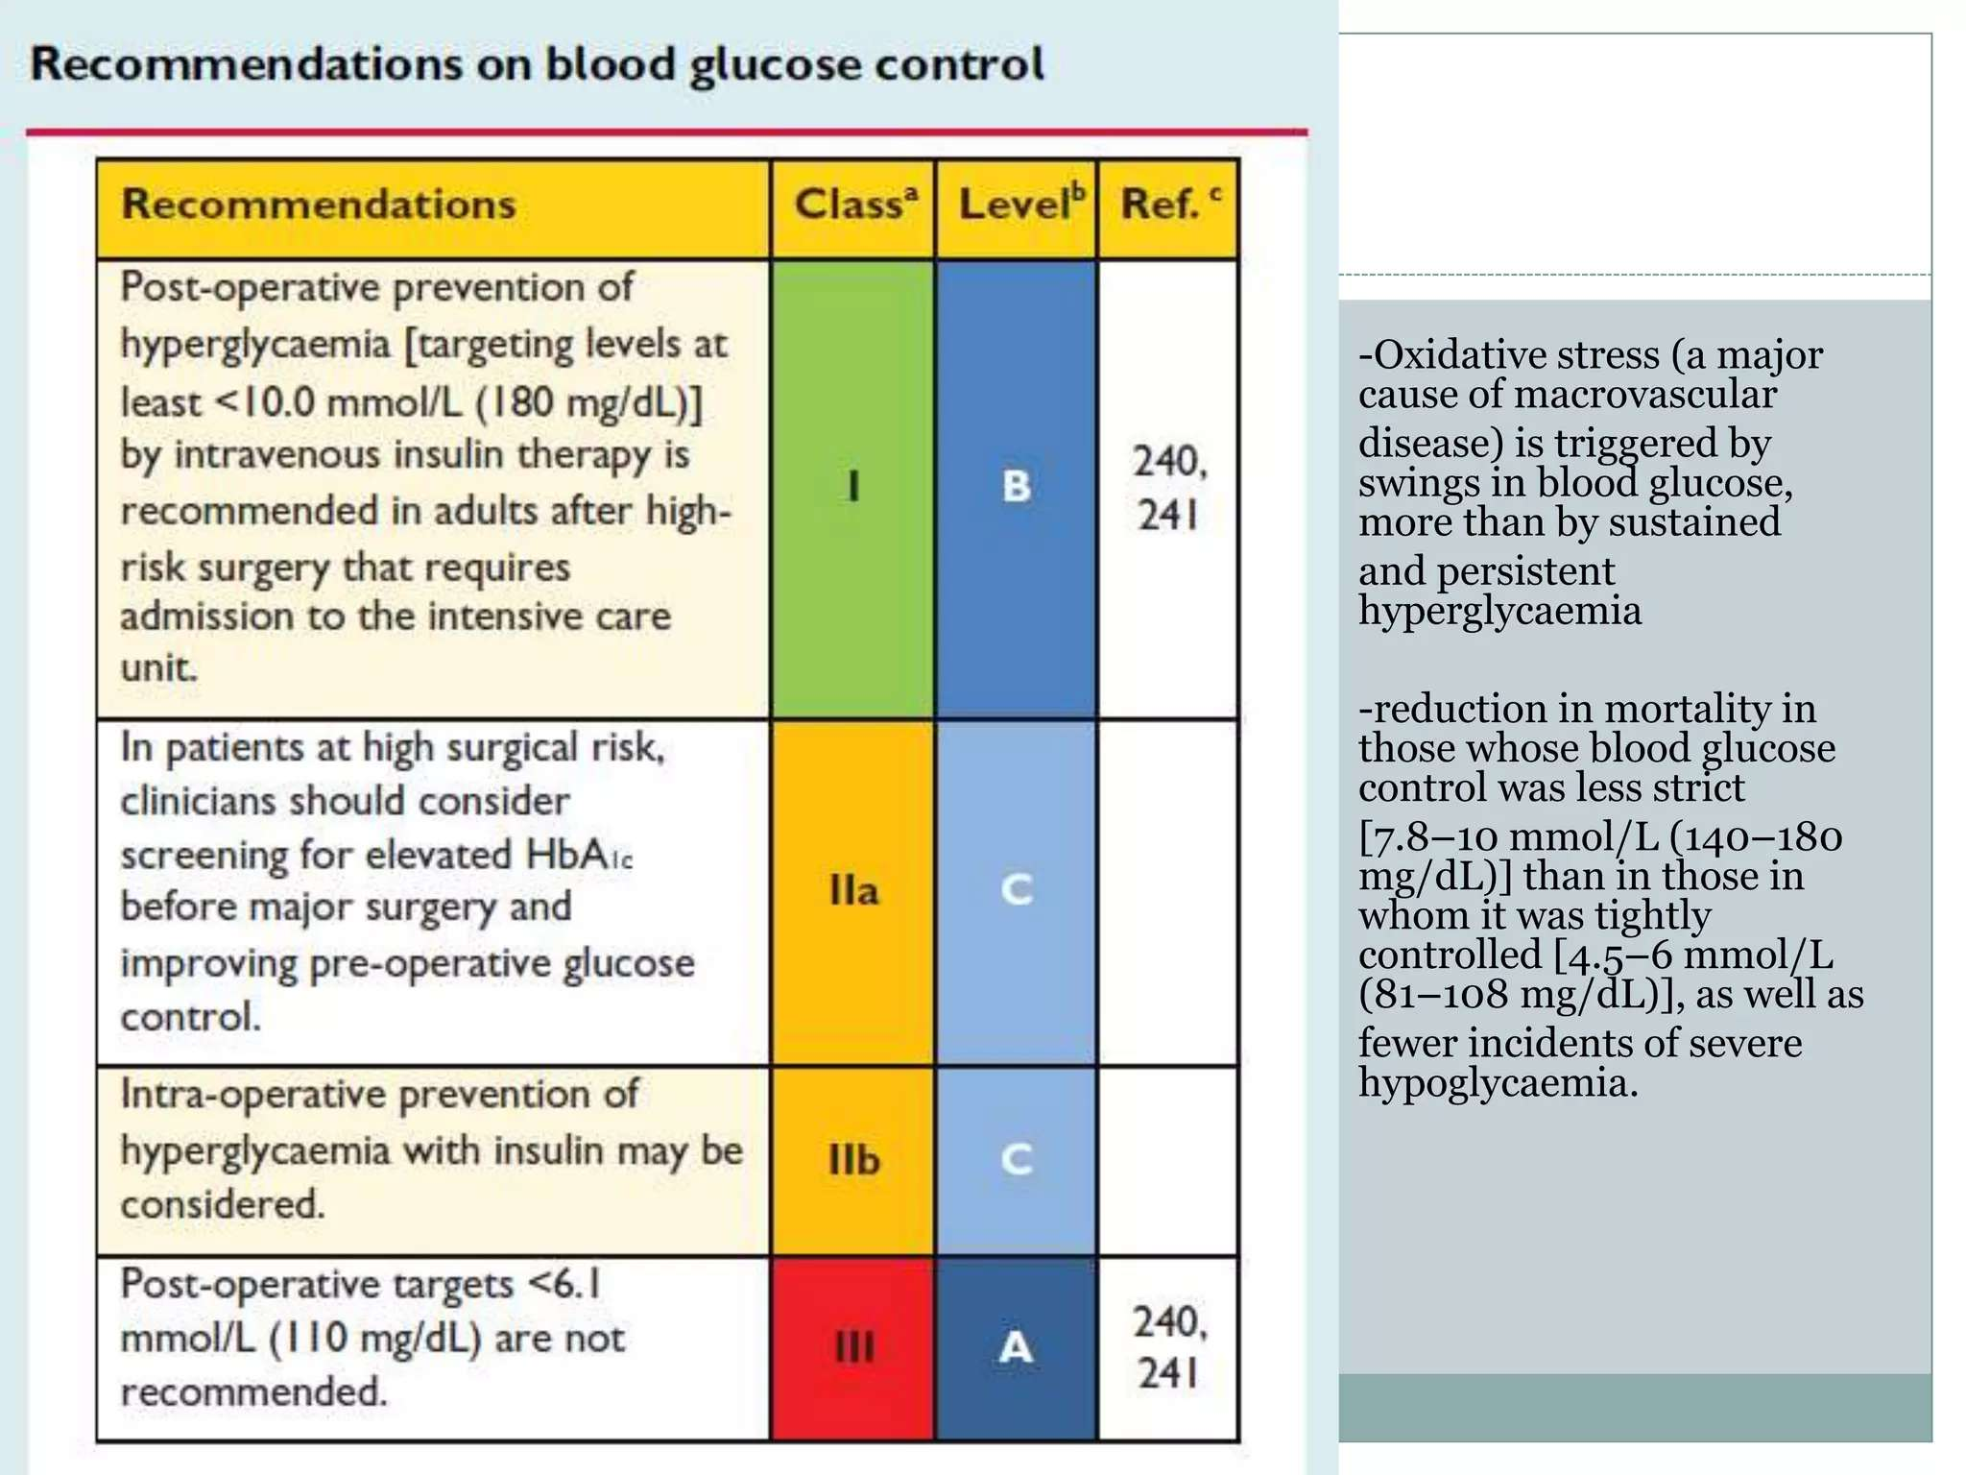

Slide 47
Thanks

