Slide 1
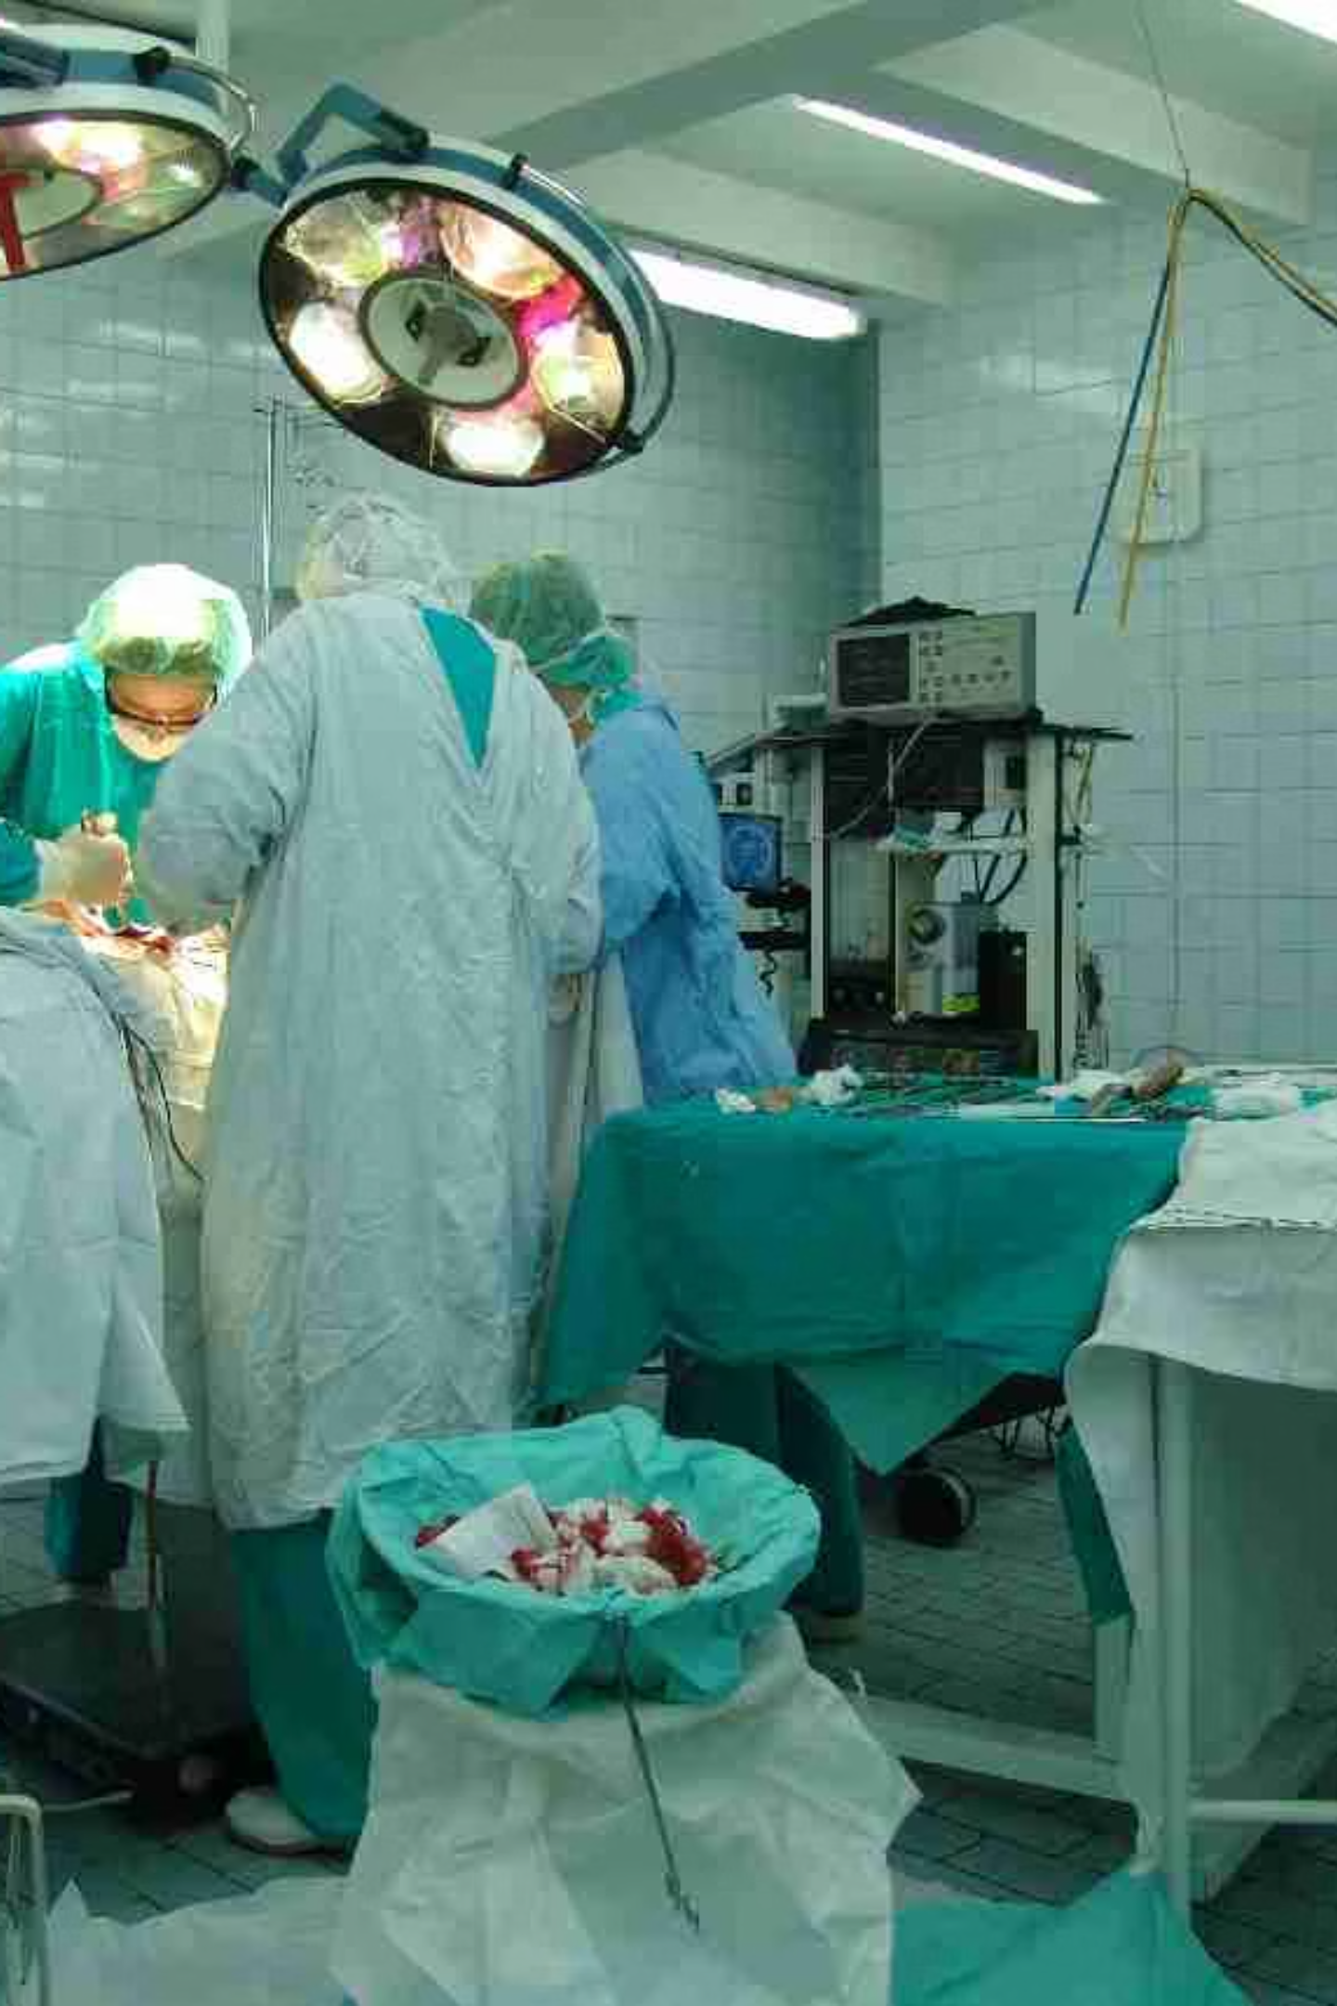
Post-Operative Complications
Recognition & Management
A clinical guide to identifying and managing the most common post-surgical complications — from atelectasis to urinary tract infections.
BY DR. SAND KASHIH

Slide 2
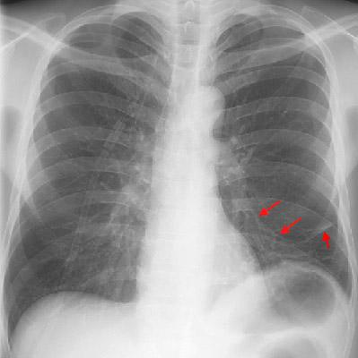
Atelectasis
PREVENTION & TREATMENT
Atelectasis — partial lung collapse — is the most common pulmonary complication after surgery, particularly following abdominal or thoracic procedures.
Risk Factors
Prevention
Prolonged immobility
Shallow breathing from pain
General anesthesia
Incentive spirometry
Early ambulation
Adequate pain control
Management
Chest physiotherapy
CPAP or BiPAP if severe
Bronchoscopy for mucus plugs

Slide 3
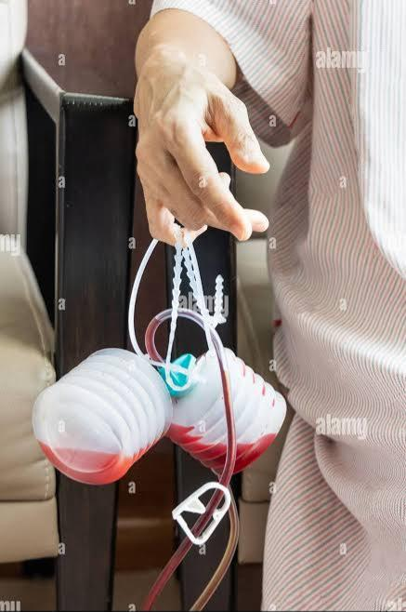

Post-Operative Hemorrhage
IDENTIFICATION & INTERVENTION
Early Recognition
Hemorrhage may present with tachycardia, hypotension, falling hemoglobin, or visible wound drainage. Early signs often precede overt shock.
Immediate Actions
Apply direct pressure to wound
IV access and fluid resuscitation
Transfuse blood products as needed
Return to OR if hemodynamically unstable
Suspect internal bleeding when vital signs deteriorate without obvious external blood loss.

Slide 4
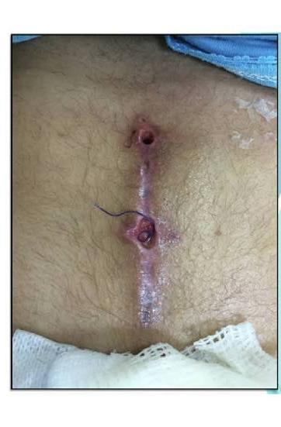
Surgical Site Infections (SSI)
PROPHYLAXIS & MANAGEMENT
Prevention
Preoperative antibiotics within 60 min of incision, sterile technique, glucose control, and normothermia reduce SSI risk significantly.
Classification
Superficial: skin and subcutaneous tissue. Deep: fascia and muscle. Organ/space: any body part opened during surgery.
Treatment
Wound culture, targeted antibiotics, and surgical debridement or drainage when abscess is present. Consider negative pressure therapy for complex wounds.

Slide 5
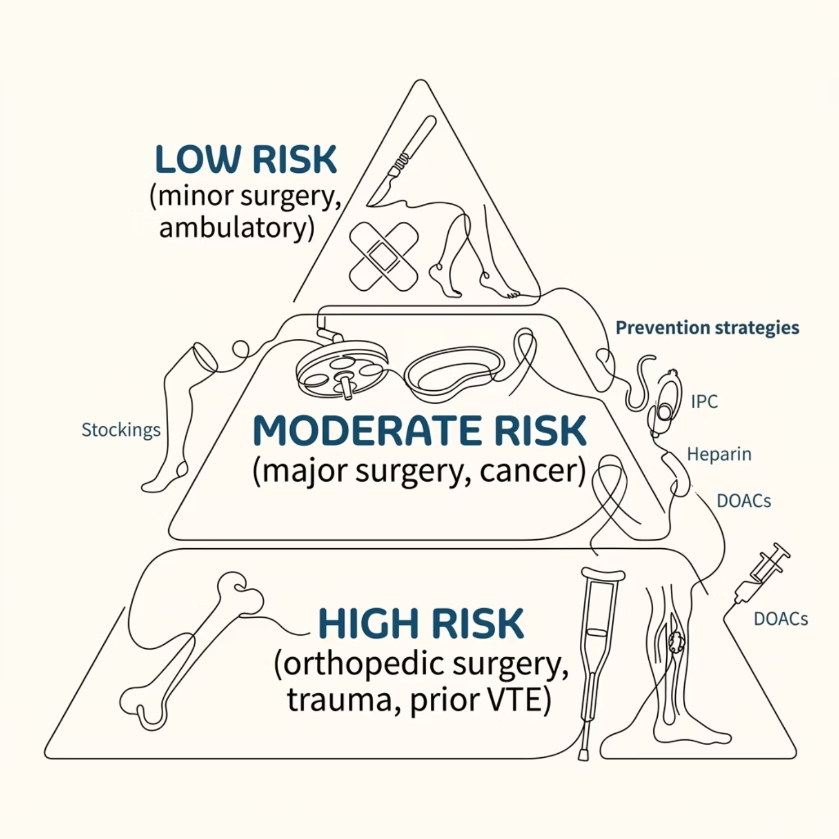

Venous Thromboembolism (VTE)
RISK ASSESSMENT & PREVENTION
Why It Matters
VTE — encompassing DVT and PE — is a leading cause of preventable post-operative mortality. Risk stratification using tools like the Caprini Score guides prophylaxis intensity.
Key Prevention Strategies
Early mobilization post-surgery
Mechanical compression devices
Pharmacological anticoagulation
Extended prophylaxis for high-risk patients

Slide 6

Post-Operative Ileus
UNDERSTANDING & EXPEDITING RECOVERY
Ileus is a temporary disruption of bowel motility following surgery, most common after abdominal procedures. Distinguishing it from mechanical obstruction is critical.
Multimodal Analgesia
Early Feeding
Introduce enteral nutrition when tolerated.
Use nonopioid strategies; minimize opioids.
Bowel Rest
Mobilize & Monitor
Nil per os and NG decompression as needed.
Encourage ambulation and assess bowel return.
Enhanced Recovery After Surgery (ERAS) protocols — including opioid-sparing analgesia, gum chewing, and early feeding — have significantly reduced ileus duration and hospital stays.

Slide 7
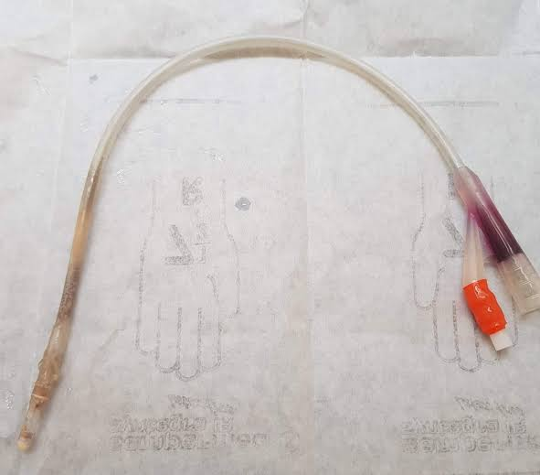
Urinary Tract Infections (UTIs)
DIAGNOSIS & TREATMENT
Risk Factors
Indwelling urinary catheters (CAUTI)
Prolonged catheterization
Female gender, advanced age
Diabetes and immunosuppression
Diagnosis
Urinalysis with pyuria, urine culture (>10⁵ CFU/mL), and clinical symptoms (fever, dysuria, suprapubic pain). Remove catheter early whenever possible.
Treatment
Empiric antibiotics (e.g., ceftriaxone, nitrofurantoin) adjusted per culture results. Catheter removal or replacement is essential for source control.

Slide 8

Key Takeaways
ENHANCING PATIENT OUTCOMES
01
Prevent Early
ERAS protocols, early mobilization, and appropriate prophylaxis reduce complication rates across all categories.
02
Recognize Promptly
Vigilant monitoring of vital signs, wound appearance, and laboratory trends enables early intervention.
03
Treat Decisively
Evidence-based, targeted management — from antibiotics to surgical re-exploration — improves outcomes and reduces mortality.
04
Reassess Continuously
Post-operative care is dynamic. Re-evaluate risk stratification and adjust management as the patient's condition evolves.

