Slide 1
Enhanced Recovery After Surgery
(ERAS protocol)
By Dr Najeeb Othman
Supervisor Dr sanad hesam

Slide 2
ERAS Overview
Enhanced Recovery After Surgery (ERAS)
Multimodal perioperative care pathway
Aim: reduce surgical stress & improve recovery

Slide 3
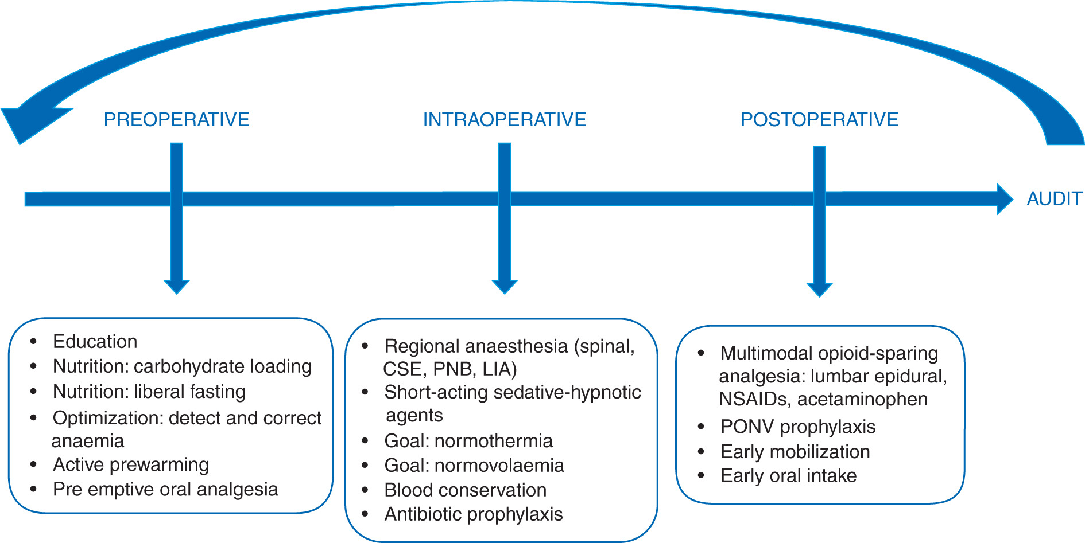

Slide 4
Principles of ERAS
Evidence-based protocol
Multidisciplinary approach
Reduce complications
Shorten hospital stay

Slide 5
Preoperative Care
Patient education & counseling
Optimize comorbidities
Avoid prolonged fasting
Carbohydrate loading

Slide 6
Preoperative Optimization
Smoking cessation
Nutritional support
Anemia correction
Prehabilitation

Slide 7
Intraoperative Strategies
Minimally invasive surgery
Goal-directed fluid therapy
Normothermia maintenance
Short-acting anesthetics

Slide 8
Analgesia in ERAS
Multimodal analgesia
Reduce opioids
Epidural/Regional blocks
NSAIDs & paracetamol

Slide 9
Postoperative Care
Early mobilization
Early oral feeding
Remove drains early
Prevent ileus

Slide 10
Fluid Management
Avoid overload
Goal-directed therapy
Maintain euvolemia
Monitor urine output

Slide 11
Outcomes of ERAS
↓ Complications
↓ Length of stay
↓ Cost
↑ Patient satisfaction

Slide 12
Key Take Home Messages
Standardized protocols improve outcomes
Early recovery is achievable
Teamwork is essential
Patient-centered care

Slide 13


