Slide 1

Anesthesia consideration and patient safety
Dr.AmatAllah Mathkor

Slide 2


Objectives
Patient safety in anesthesia involves:
*1 Preoperative assessment: Hx,clinical examination,investigation,NPO status
*2 Preoperative preparation for anesthesia machine and equipment,emergency drug and equipment .
*3 Monitoring during anesthesia
*4 Infection control
*5 teamwork communications
Risk assessment
*ASA scoring
*Airway risk assessment
*Cardiac risk assessment
Types of anesthesia

Slide 3
Part 1:
1.1 Pre-Anesthetic Evaluation (History, Exam, Labs,NPO status)

Slide 4
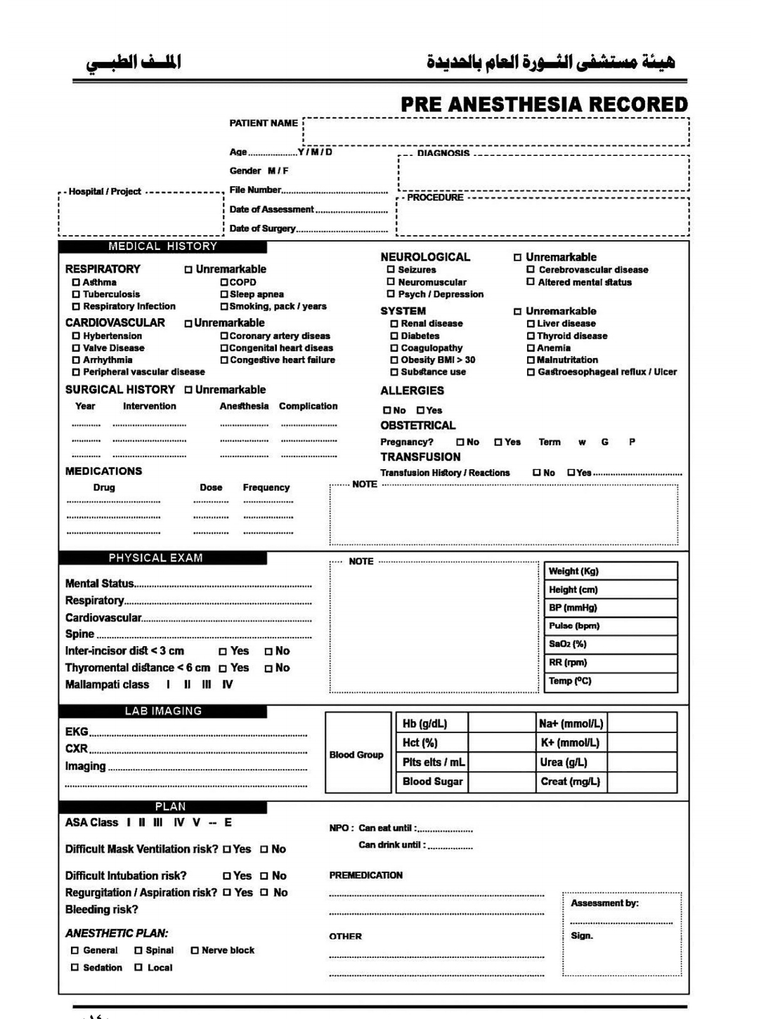

Slide 5
Medical History – High-Yield Elements
Allergies Latex, drugs (propofol – egg/soy), antibiotics, local anesthetics (ester vs amide) Avoid trigger; consider pretreatment
Cardiac Angina, CHF, dyspnea, HTN, valve disease Risk of ischemia, pulmonary edema, arrhythmias
Pulmonary COPD, asthma, OSA, URI in last 2 weeks Reactive airway disease, difficult airway, postoperative pulmonary complications
Renal Creatinine >2 mg/dL, dialysis Drug excretion (e.g., morphine, rocuronium), fluid balance
Hepatic Cirrhosis, hepatitis Altered drug metabolism (e.g., benzodiazepines), coagulopathy
Endocrine Diabetes (insulin-dependent), thyroid, adrenal Hypoglycemia, difficult airway (thyromegaly), steroid coverage
Previous anesthesia Difficult intubation, PONV, malignant hyperthermia, prolonged paralysis Plan for awake intubation, antiemetics, dantrolene availability, avoid succinylcholine
Family history MH, pseudocholinesterase deficiency, bleeding disorders Trigger-free machine, avoid succinylcholine, check coags
Medications Anticoagulants (DOACs, warfarin), beta-blockers, ACEi, insulin, steroids, MAOIs Stop/continue protocols; hypotension risk; serotonin syndrome risk
Social history Smoking, alcohol, illicit drugs Airway hyperreactivity, tolerance to sedatives, withdrawal risk
NPO status Last oral intake Risk of aspiration – 2h clear liquids, 6h light meal, 8h fatty meal

Slide 6
Laboratory Investigations – Evidence-Based Ordering (Not Routine)
Test Indication
CBC Expected blood loss >500 mL, renal/liver disease, age >65 with major surgery
Creatinine/GFR Age >60, major surgery, DM, HTN, CHF, nephrotoxic drugs
Glucose Diabetes mellitus, major surgery
ECG Age >65, known cardiac disease, intermediate/high-risk surgery
Troponin Chest pain, dyspnea, high-risk surgery (vascular)
Pregnancy test All women of childbearing age if pregnancy possible
Coagulation panel (INR/PTT) Anticoagulant use, liver disease, malnutrition, bleeding history

Slide 7
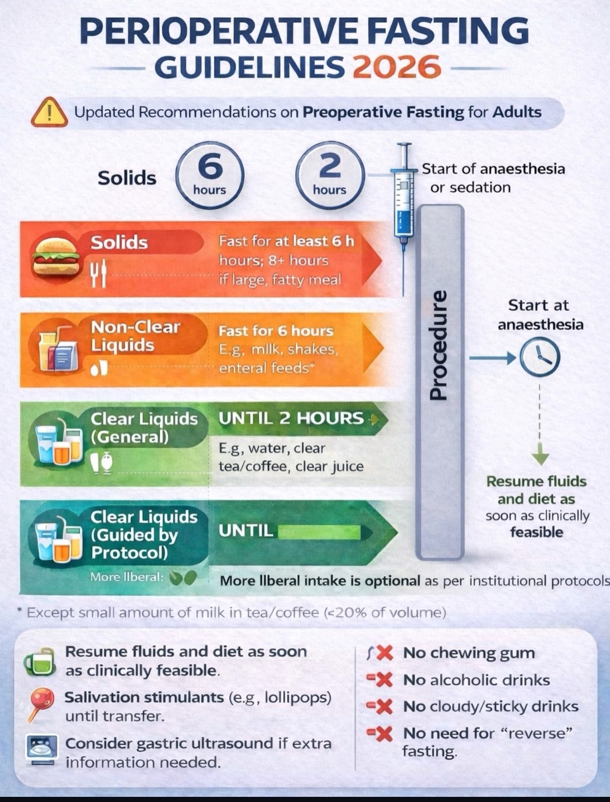
NPO status

Slide 8
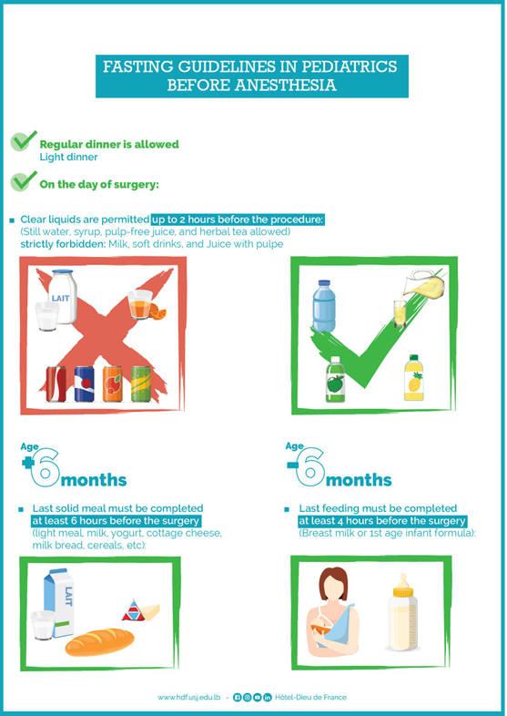

Slide 9
Ingested material Minimum fasting time
Clear liquids (water, black coffee, clear juice) 2 hours
Breast milk 4 hours
Infant formula 6 hours
Light meal (toast, tea) 6 hours
Fatty meal or meat 8 hours
⨁ Exceptions (full stomach despite NPO):
· Emergency surgery
· Gastroparesis (diabetes, opioids)
· Bowel obstruction
· Severe GERD
· Pregnancy (≥18 weeks)
· Morbid obesity (BMI >40)
Management: Rapid sequence induction (RSI) with cricoid pressure (or modified RSI without cricoid if contraindicated).

Slide 10
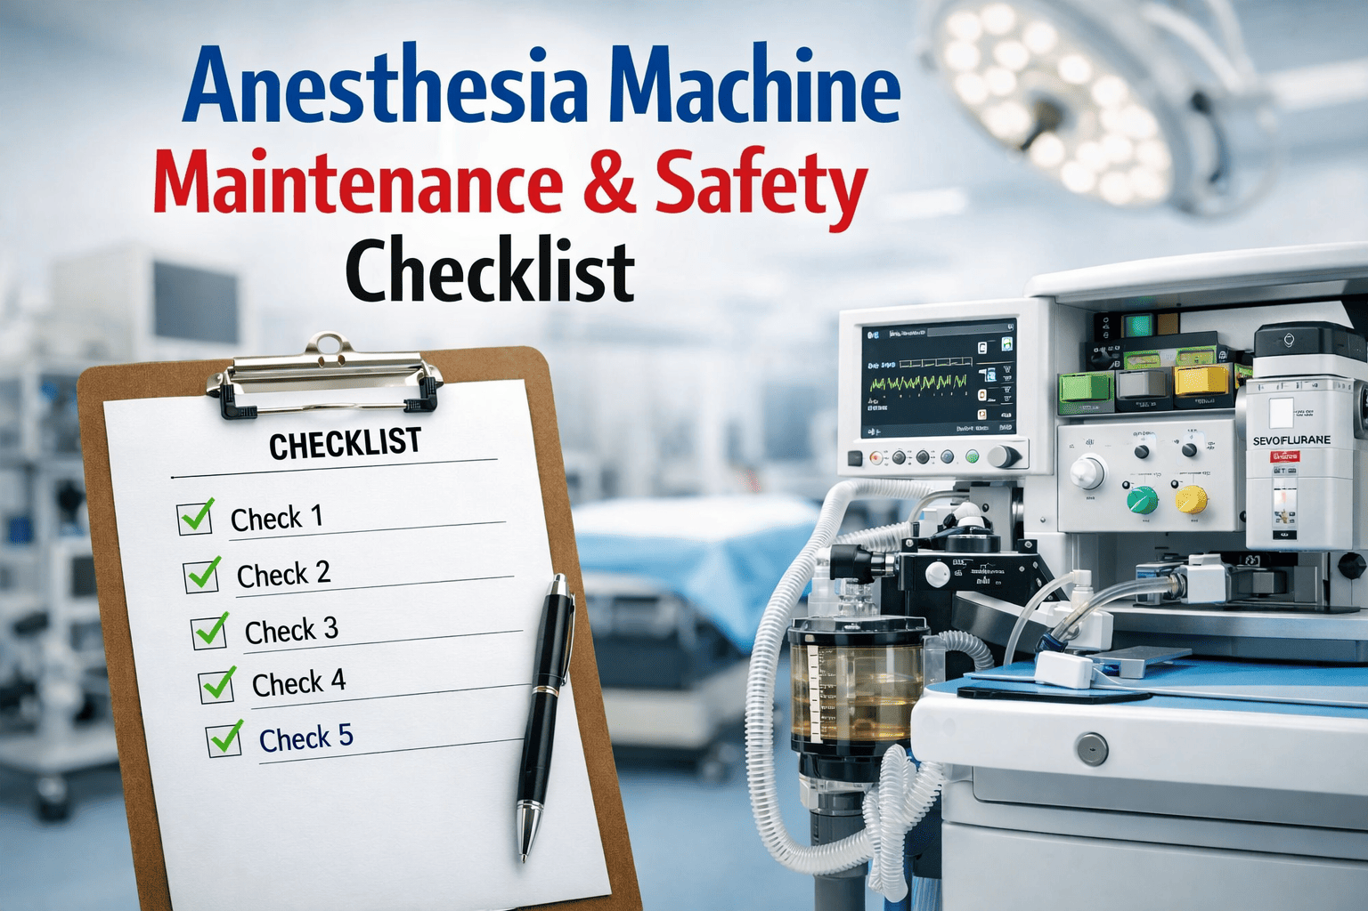
1.2 Preparation & Equipment (Ensuring Safety)

Slide 11
Anesthesia Machine Check (Daily & Before Each Case)
Gas supply – cylinder pressures (>1000 psi O₂), pipeline pressures (50 psi), backup O₂ available
· Vaporizers – filled, seated correctly, not leaking
· CO₂ absorbent – fresh, not exhausted (color change indicates exhaustion)
· Breathing circuit – no leaks (occlude Y-piece, pressure to 30 cmH₂O holds), unidirectional valves working
· Ventilator – bellows move appropriately, alarms functional
· Suction – adequate negative pressure (>300 mmHg), Yankauer and suction catheter available
· Scavenging system – connected, not obstructed

Slide 12
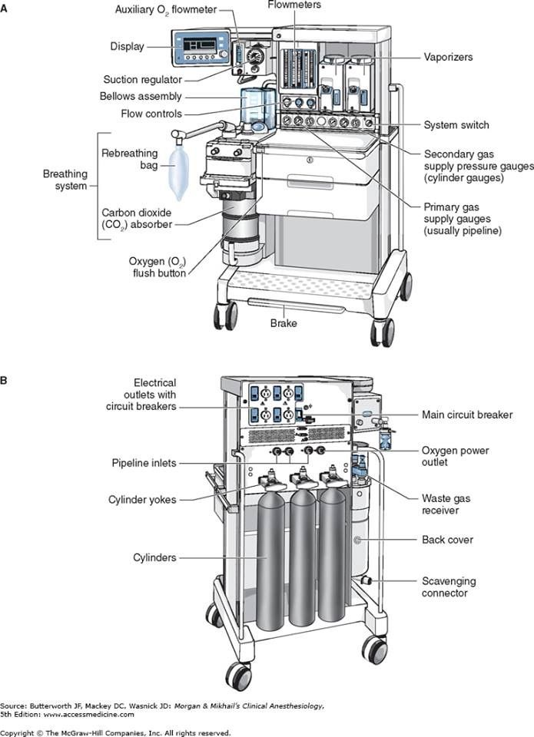

Slide 13
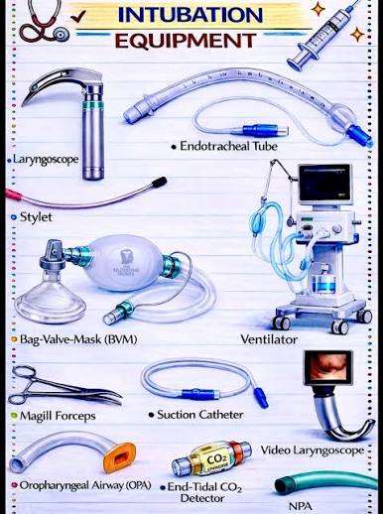
Emergency Equipment – The "Must Have" Ready
Difficult airway cart contents (check daily):
· Laryngoscopes (Macintosh and Miller blades sizes 2,3,4) with spare batteries/bulbs
· Video laryngoscope (Glidescope, McGrath)
· Supraglottic airways (LMA sizes 3,4,5)
· Endotracheal tubes (sizes 6.0–8.5 with stylets)
· Bougie (gum elastic bougie)
· Emergency surgical airway (cricothyrotomy kit, large-bore IV, scalpel)
· OPA and NPA (all sizes)

Slide 14
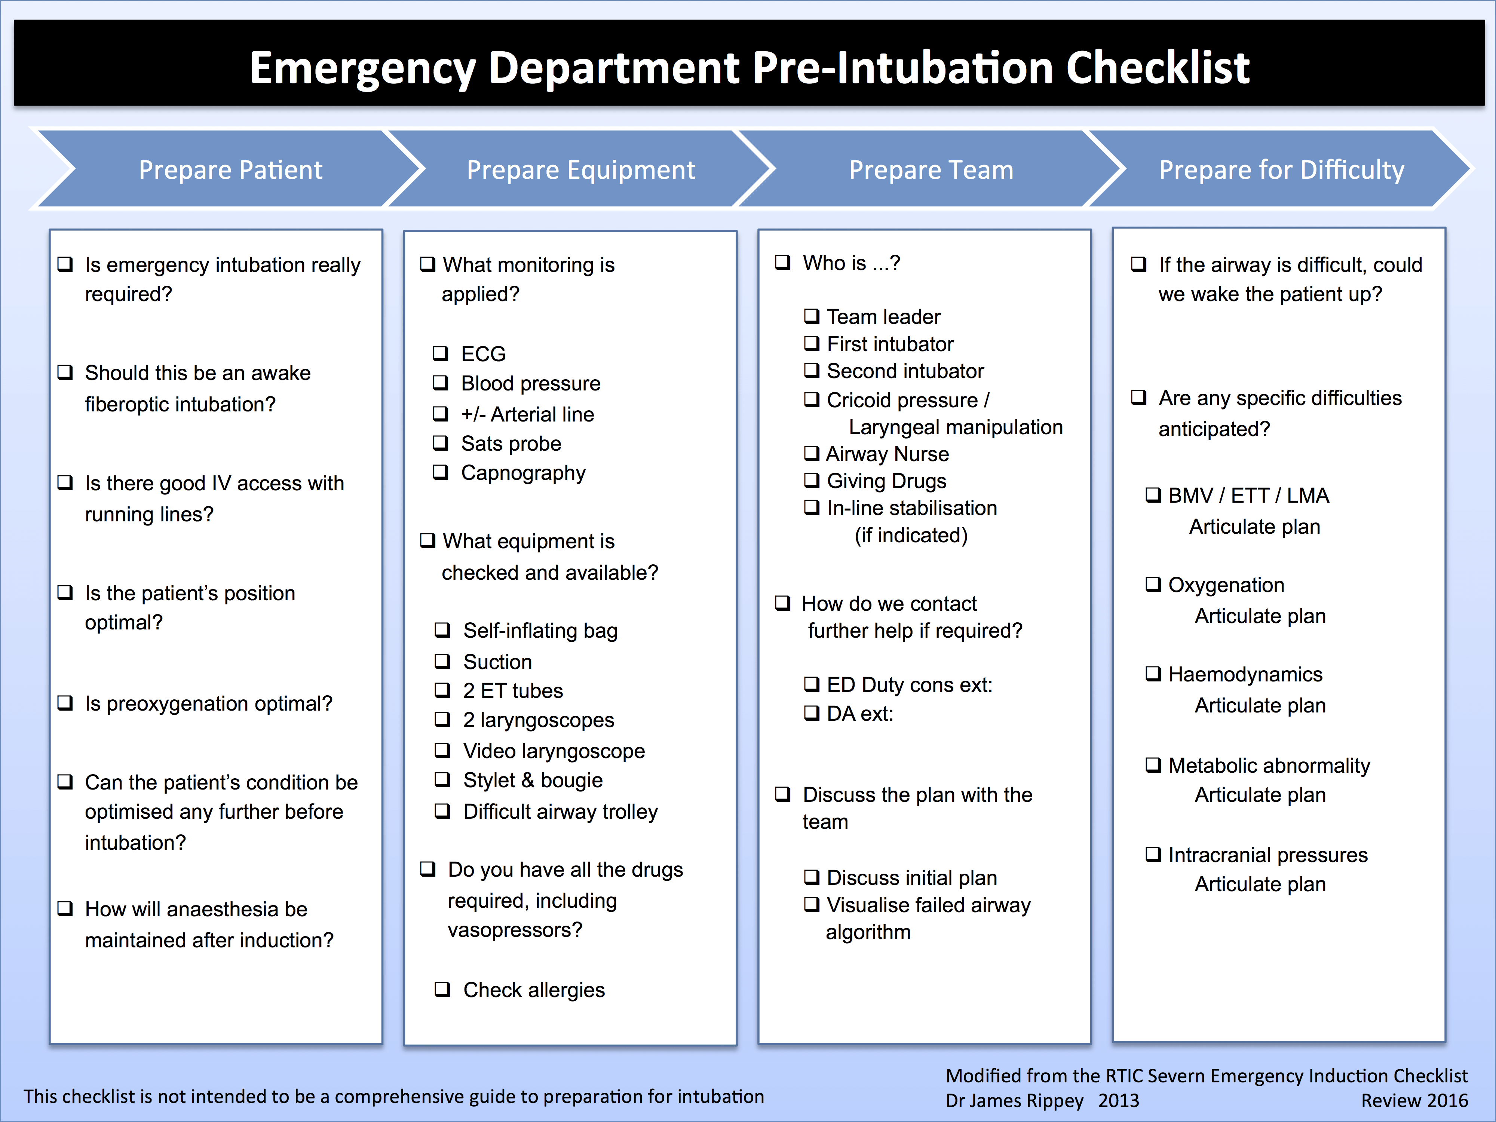

Slide 15
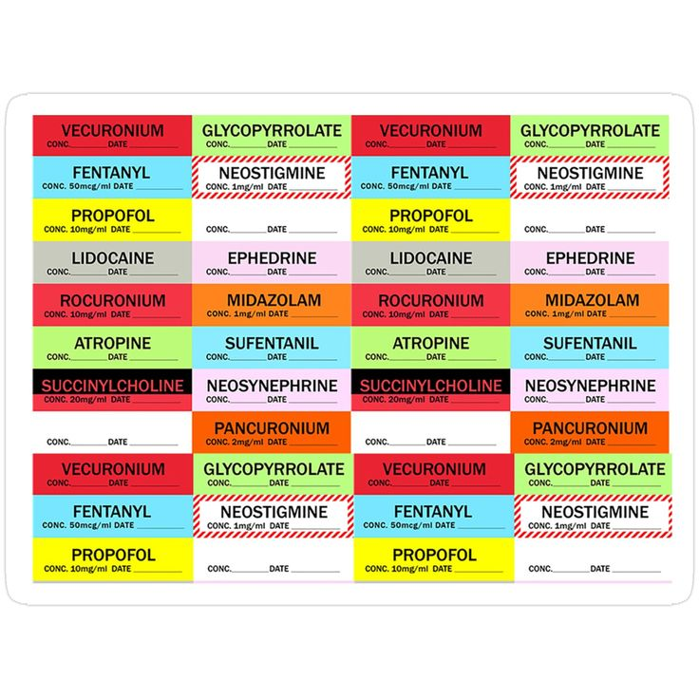
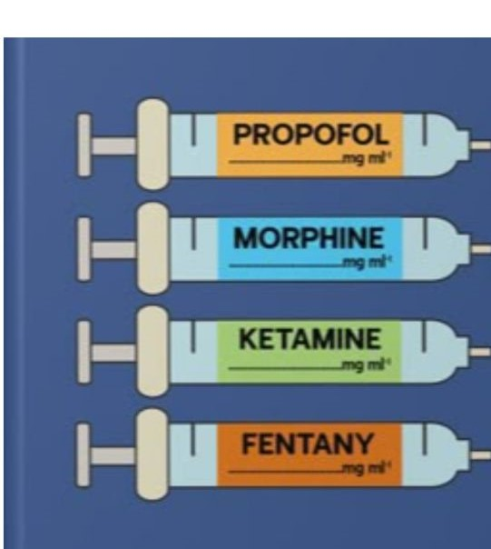
Emergency drugs (pre-drawn syringes, labeled, and dated

Slide 16
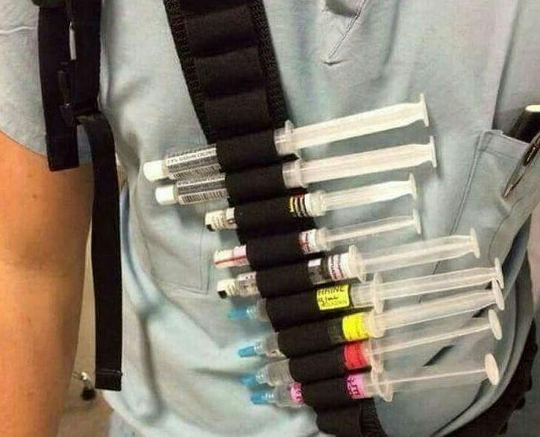
Drug Concentration Use:
Epinephrine 10 mcg/mL (1:100,000) Anaphylaxis, cardiac arrest
Phenylephrine 100 mcg/mL Hypotension
Ephedrine 5 mg/mL Hypotension with bradycardia
Atropine 0.1 mg/mL Bradycardia
Succinylcholine 20 mg/mL RSI, laryngospasm
Sugammadex 100 mg/mL Reversal of rocuronium/vecuronium
Naloxone 0.04 mg/mL Opioid reversal
Flumazenil 0.1 mg/mL Benzodiazepine reversal
Dantrolene (MH) – Malignant hyperthermia (reconstituted)

Slide 17
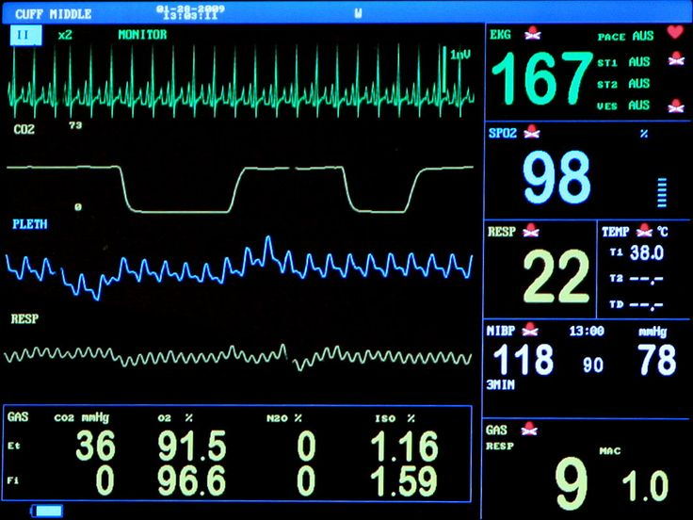
3.1 Intraoperative Monitoring (Standards & Advanced)

Slide 18
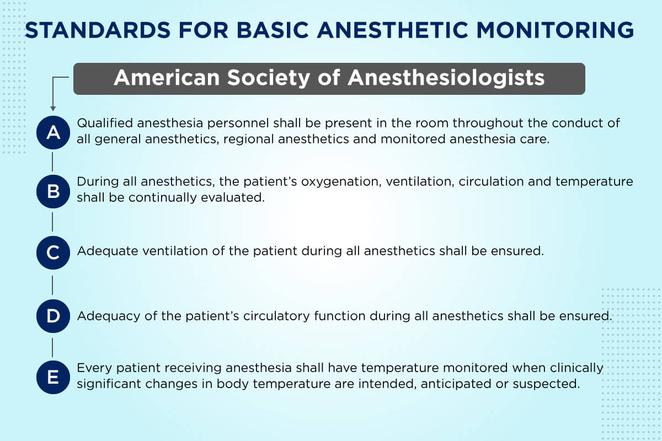

Slide 19
Basic Standards (Required for Every Patient – ASA Guidelines)
ECG (lead II and V5) Rhythm, ischemia Normal sinus; ST depression/elevation
NIBP Hemodynamic stability MAP ≥65 mmHg
Pulse oximetry (SpO₂) Oxygenation ≥94% (on room air); with O₂ ≥95%
Capnography (EtCO₂) Ventilation, circuit integrity, ETT position 35–45 mmHg; waveform confirms ETT placement
Temperature Prevent hypothermia/hyperthermia 36–37.5°C

Slide 20
Advanced Monitoring (Board-Level Knowledge)
Monitor Indication Key numbers
Arterial line Beat-to-beat BP, blood gases, unstable patients MAP target varies (usually >65)
CVP Volume status (low sensitivity) 8–12 mmHg (but not reliable alone)
Cardiac output (FloTrac, PiCCO, PAC) Shock, major cardiac/vascular surgery CI 2.5–4 L/min/m²
BIS (depth of anesthesia) Prevent awareness; reduce anesthetic use 40–60 (adequate hypnosis)
Neuromuscular monitoring (TOF) Guide reversal; avoid residual paralysis TOF ratio ≥0.9 before extubation
Transesophageal echocardiography (TEE) Valve function, wall motion, volume LVEF, regional wall motion

Slide 21
Clinical Monitoring (Don't Forget the Patient)
Pupils – small (opioids, propofol), large (light anesthesia, anticholinergics)
· Tears, sweating, hypertension, tachycardia – signs of light anesthesia
· Breathing circuit – condensation (humidification), reservoir bag movement
· Urine output – target ≥0.5 mL/kg/h (indicates renal perfusion)
· Surgical field – bleeding, surgical manipulation affecting hemodynamics

Slide 22
4.1 Infection Prevention

Slide 23
4.1 Equipment Sterilization Levels
4.2 Aseptic Technique for Regional Anesthesia & CVC

Slide 24
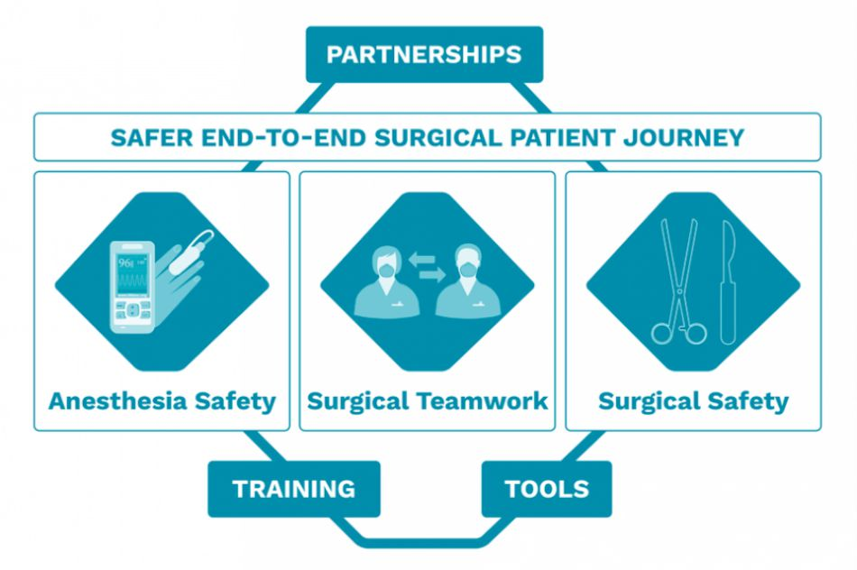
5.1 Communication & Teamwork

Slide 25
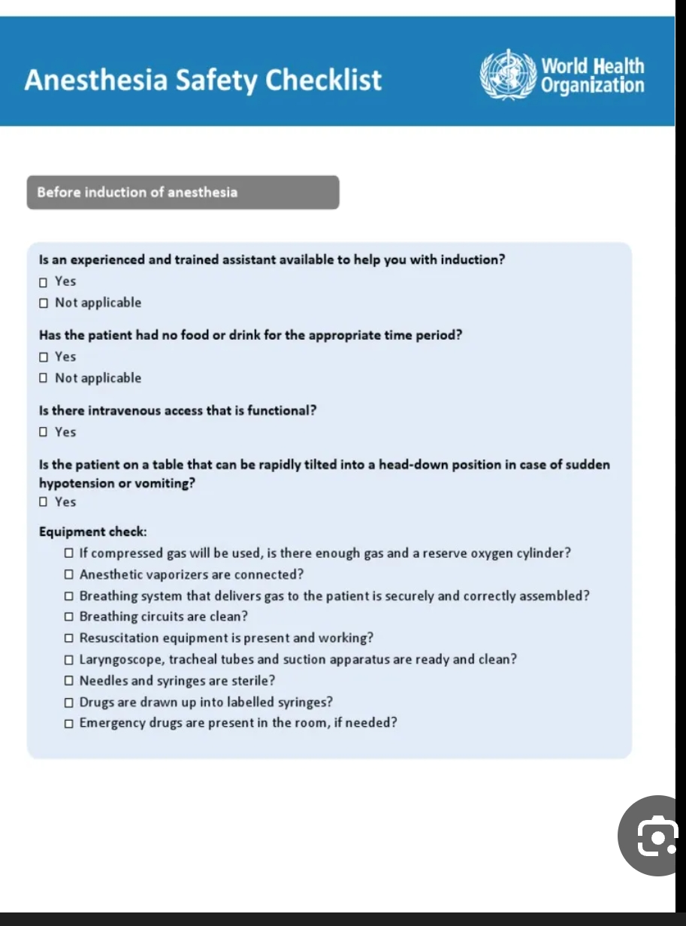

Slide 26
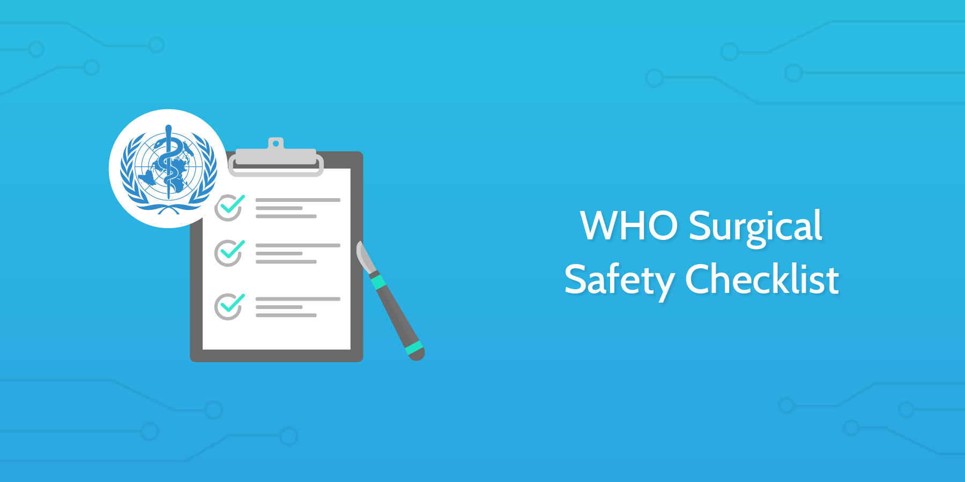

Slide 27
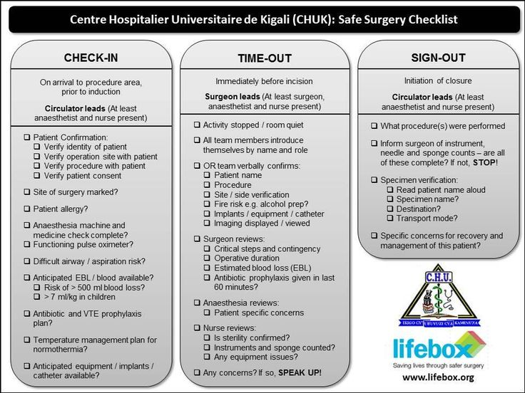

Slide 28
Component Example
Situation "I am Dr. Smith, handing over Mr. Jones, 65M, post-laparotomy."
Background "History of HTN, DM, on metformin and lisinopril. Difficult intubation Mallampati 3."
Assessment "Currently hemodynamically stable, BP 120/80, HR 90, SpO₂ 98% on facemask. Received 2 mg midazolam, 150 mcg fentanyl, sevoflurane. Reversed with sugammadex."
Recommendation "Monitor for residual paralysis. Give pain meds (morphine 2 mg IV PRN). Call me if SpO₂ drops below 94%."

Slide 29
Crisis Resource Management (CRM) Principles
· Call for help early – don't struggle alone
· Assign roles (airway, drugs, circulation, recorder, team leader)
· Use cognitive aids (difficult airway algorithm, MH protocol, PALS/ACLS cards)
· Communicate clearly – closed-loop communication ("Give 10 mcg epinephrine IV" → "10 mcg epinephrine given" → "Thank you")
· Reassess frequently – every 2-3 minutes

Slide 30
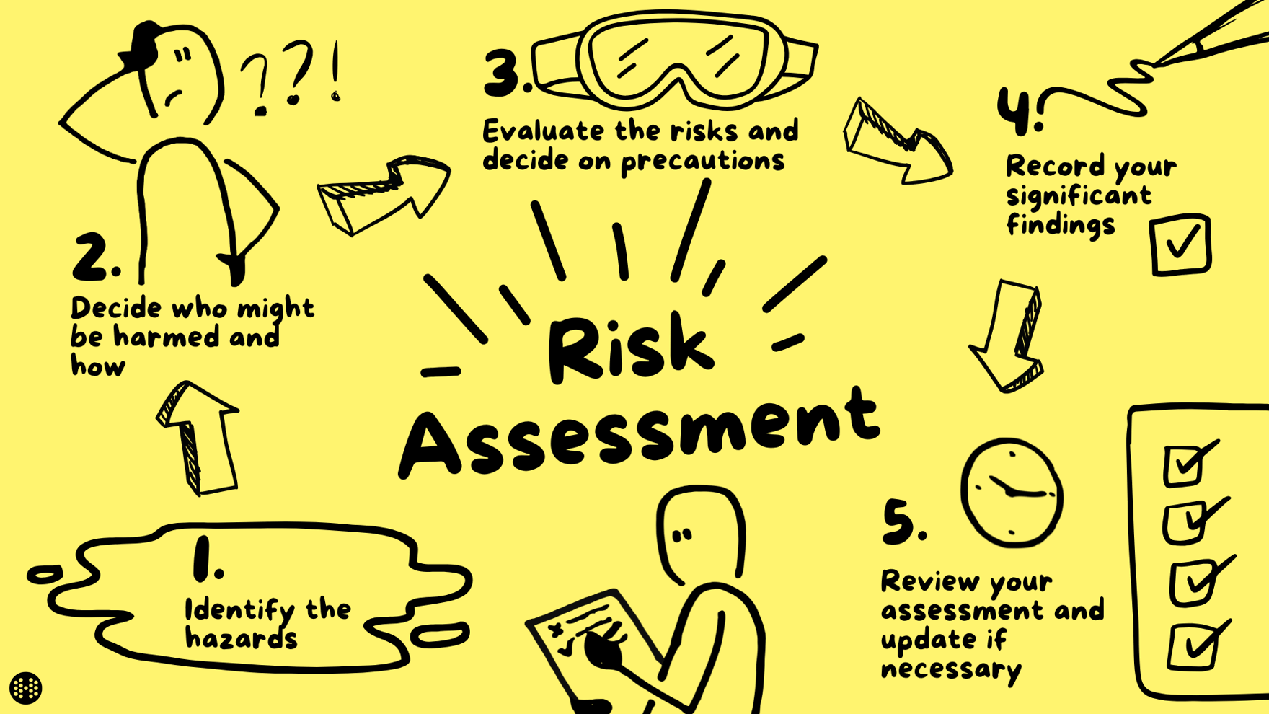

Part 2: Risk assessment

Slide 31
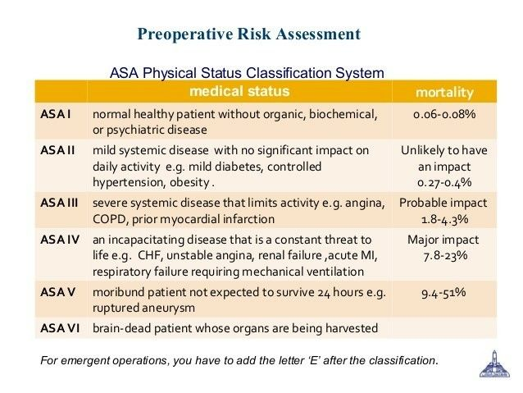
ASA (American society of Anesthesiologist

Slide 32
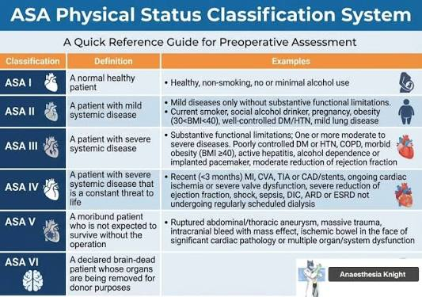
ASA

Slide 33
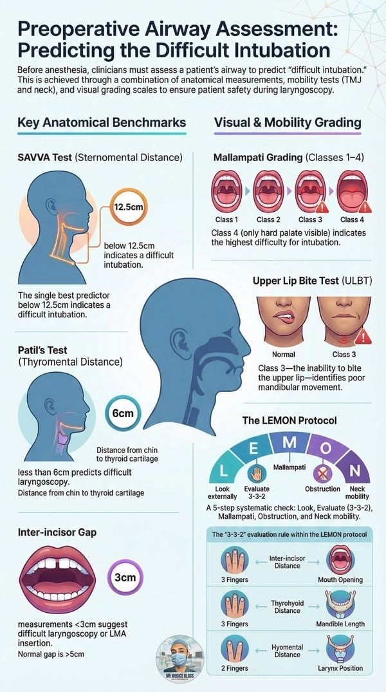
Airway risk assessment

Slide 34
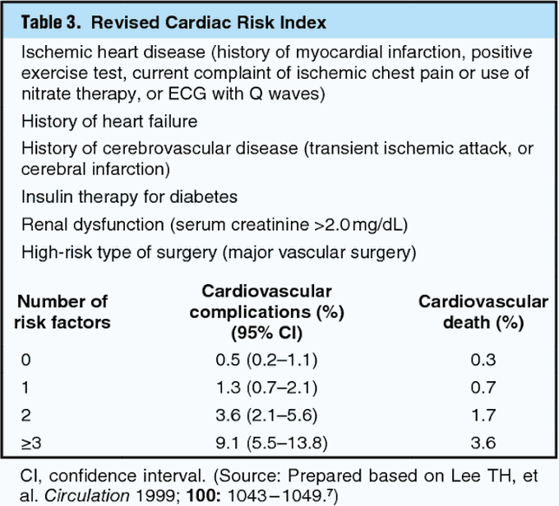
Cardiac risk assessment

Slide 35
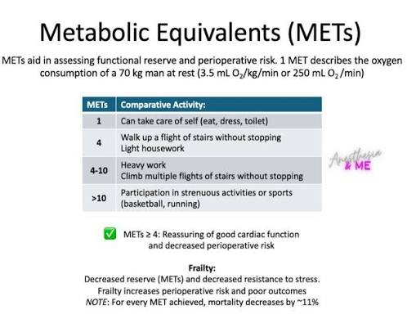
MET
· <4 METs (cannot walk 2 blocks or climb 1 flight) → high risk → consider further testing (stress echo, troponin)
· >4 METs → low risk → proceed without additional cardiac tests

Slide 36
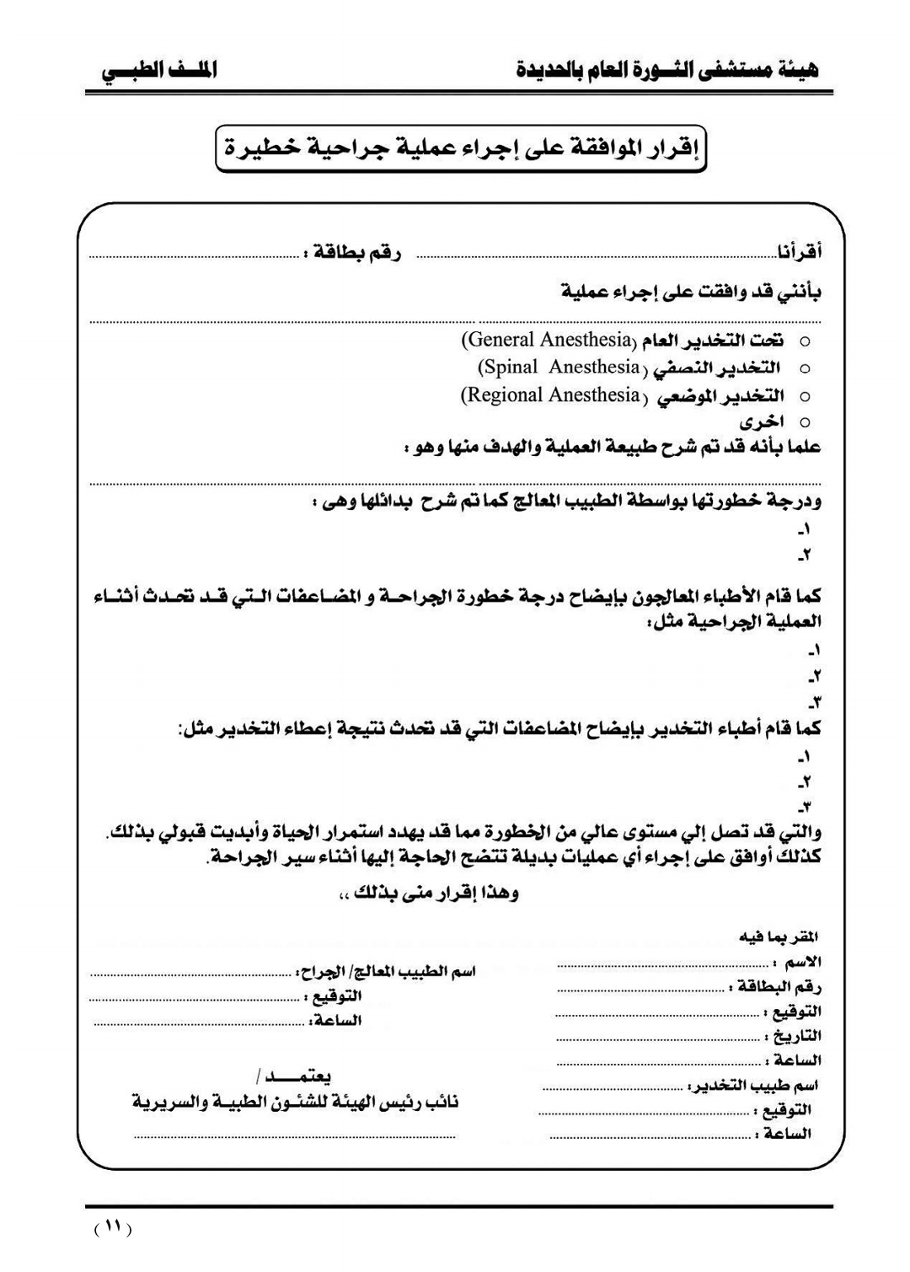

Slide 37


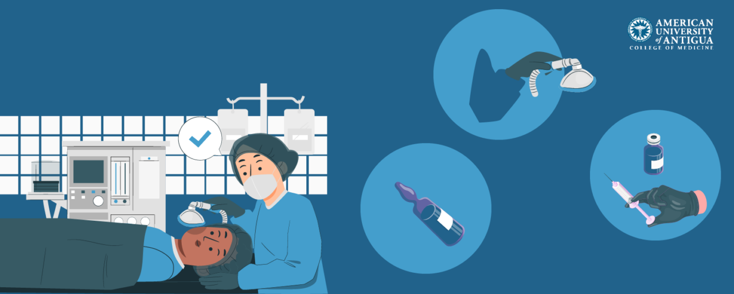
Part 4:Types of anesthesia

Slide 38
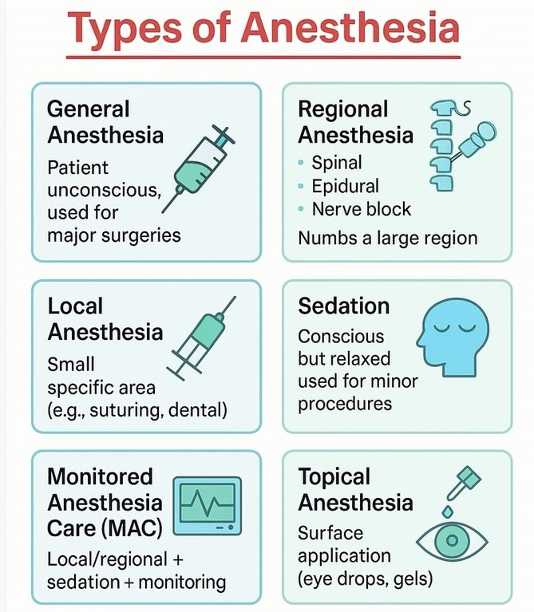

Slide 39



