Slide 1
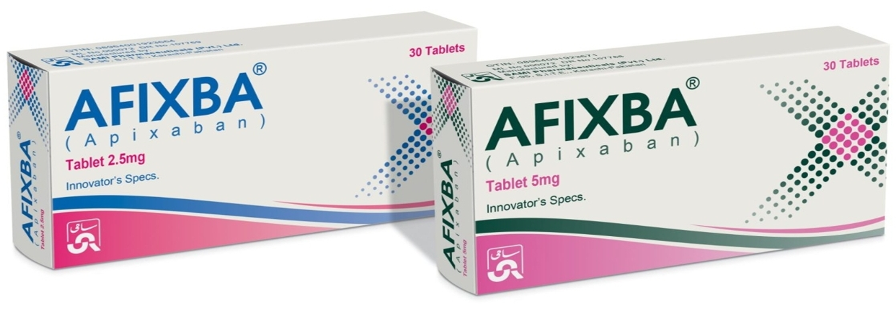
APIXABAN (AFIXBA)
Efficacy and Safety Current Evidence
and Clinical Review

Slide 2
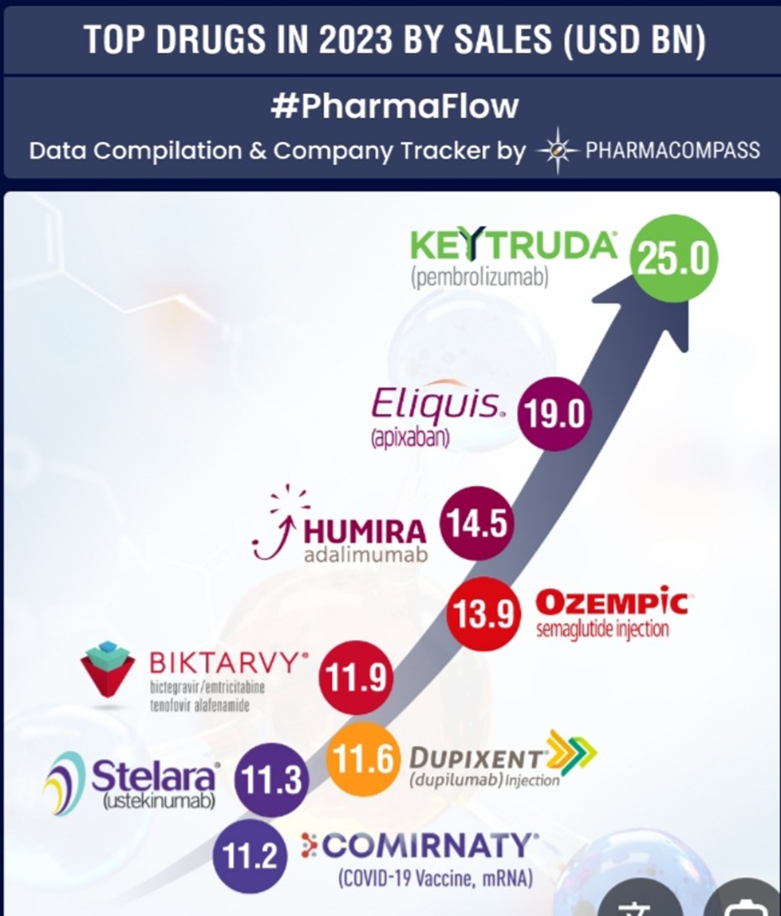

Slide 3
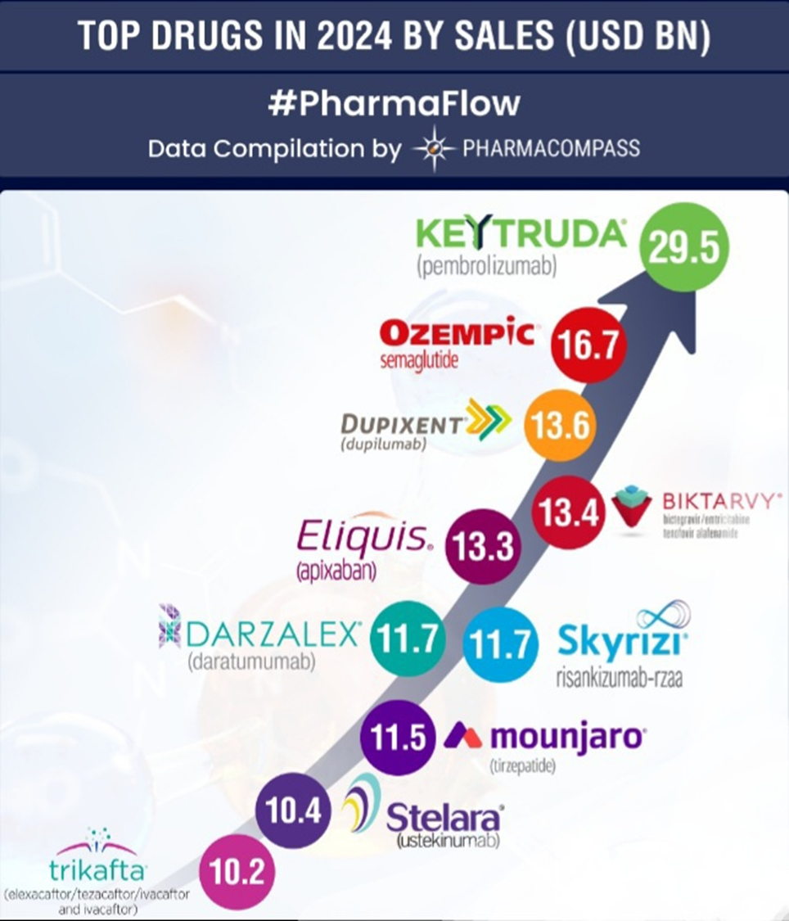

Slide 4
APIXABAN
  Potent , direct, oral, reversible, and highly selective inhibitor of FXa.
  Inhibits free and clot-bound FXa, as well as prothrombinase activity, which inhibits clot growth.

Slide 5
FDA Approved Indications
Reduction of Risk of Stroke And Systemic Embolism In Non-valvular Atrial Fibrillation
Prophylaxis of Deep Vein Thrombosis Following Hip Or Knee Replacement Surgery
Treatment of Deep Vein Thrombosis & Pulmonary Embolism
Reduction In The Risk of Recurrence of DVT And PE

Slide 6

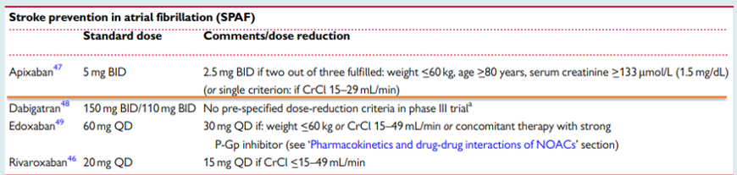
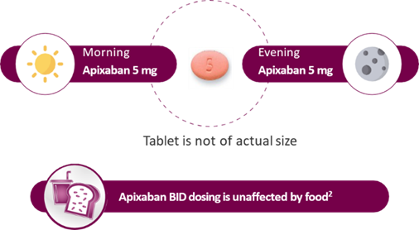

Slide 7

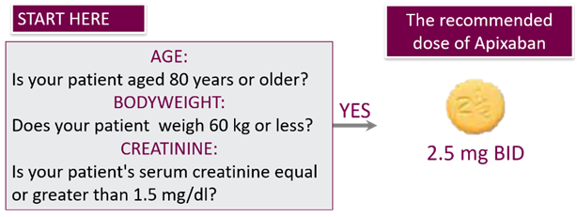
The ABC dose adjustment criteria (All NVAF patients at risk of stroke and systemic embolism):
In patients with at least 2 of the following characteristics, the dose reduction should be considered.
Therapy should be continued long-term

Slide 8
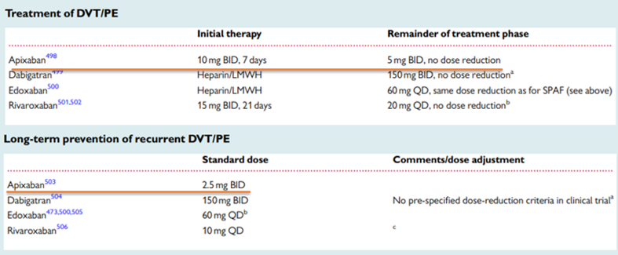
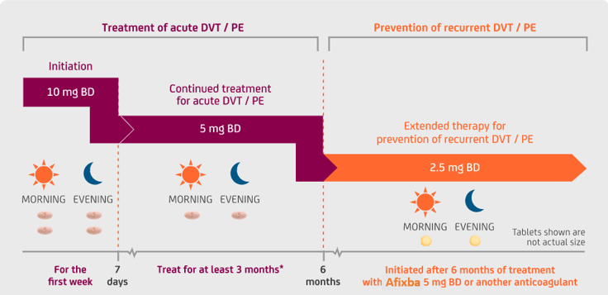
The duration of overall therapy should be individualised after careful assessment of the treatment benefit against the risk for bleeding

Slide 9

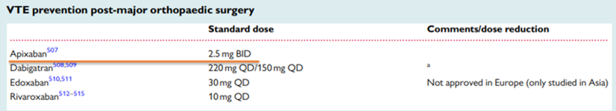
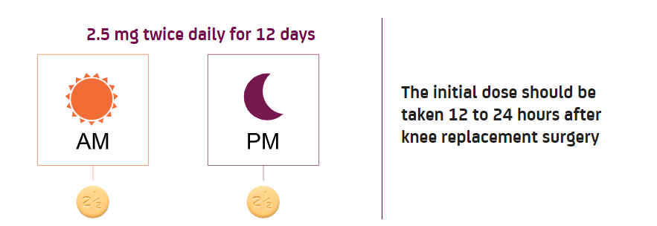
Recommended treatment durations are 32–38 days for patients having hip replacement surgery.
10–14 days for patients having knee replacement surgery.

Slide 10
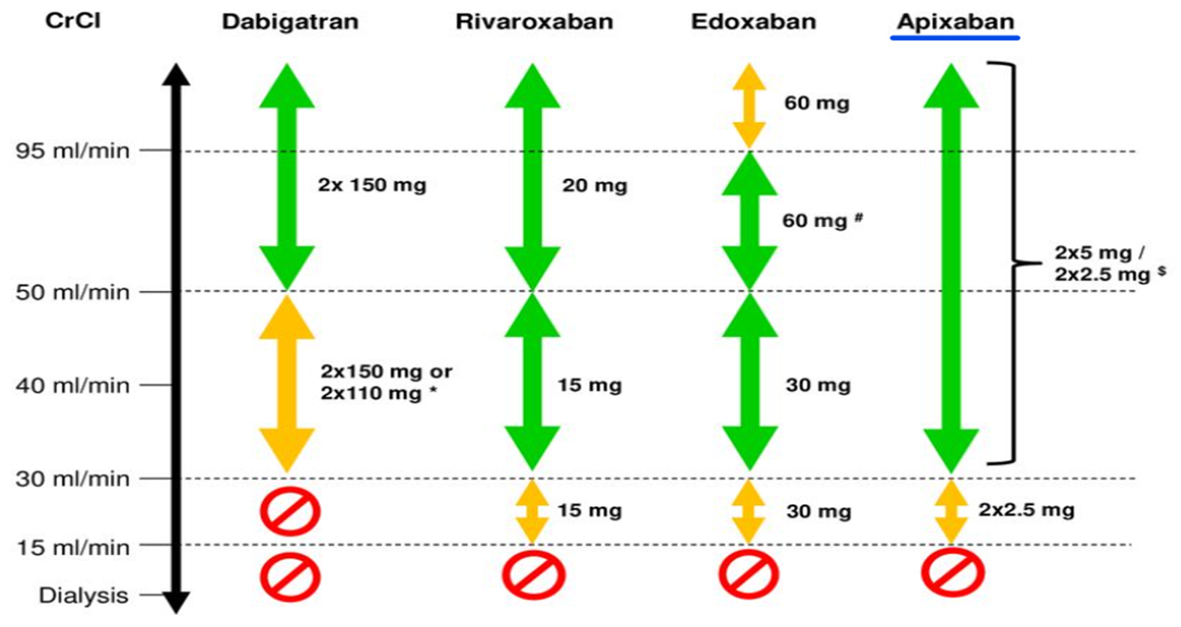
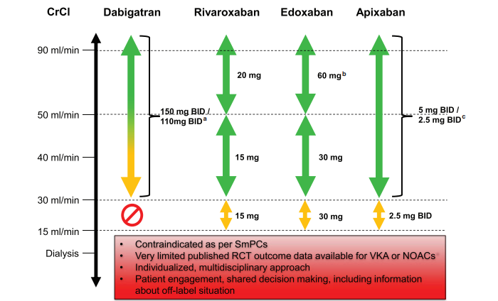

Slide 11
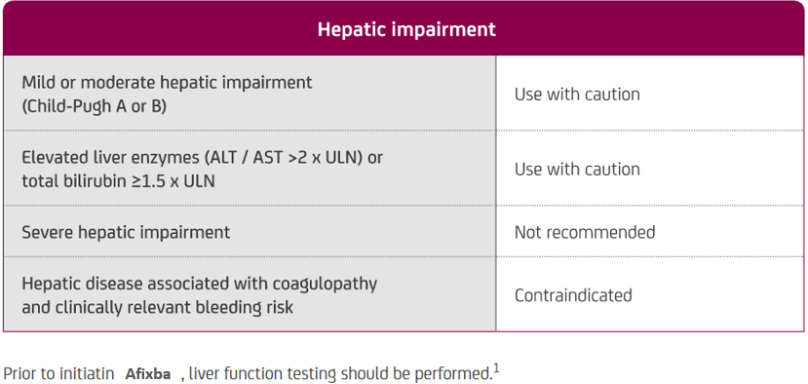
Dosing considerations in patients with hepatic impairment across all indications

Slide 12
Specific Patients Population
Pregnant Women: It is considered a pregnancy category B medicine. There is a limited amount of data available on the use of apixaban tablets in pregnant women and the associated risk of major birth defects, adverse outcomes, or miscarriage. The treatment with the drug may lead to an increased risk of bleeding during pregnancy and delivery.
Breastfeeding Women: not recommended, as human exposure via milk is still unknown.
Pediatric Patients: ≤ 18years . No data are available.
Geriatric Patients: There is no clinically significant difference.

Slide 13
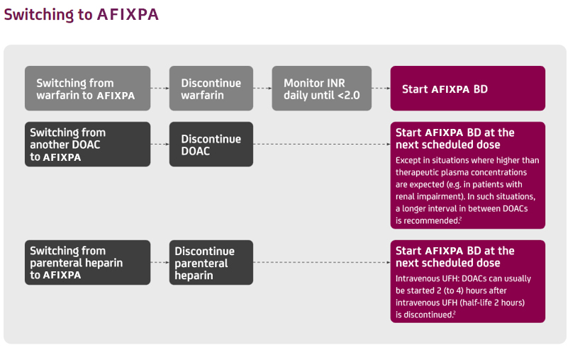
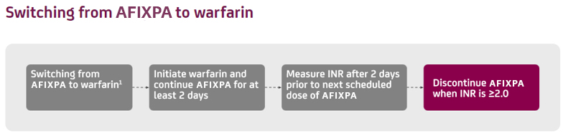

Slide 14
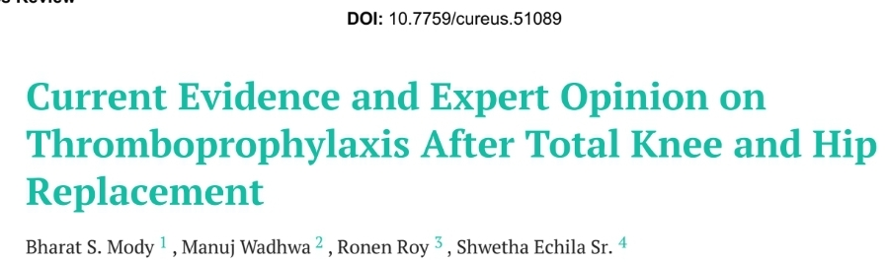
In Total Hip or Total Knee Replacement
Expert opinion December 25, 2023
Notes:
The major goals of treating patients with CAD are to
Reduce patients' risk of major adverse CV events,
Prolong life, and
Improve symptoms, functional status, and quality of life. :

Slide 15
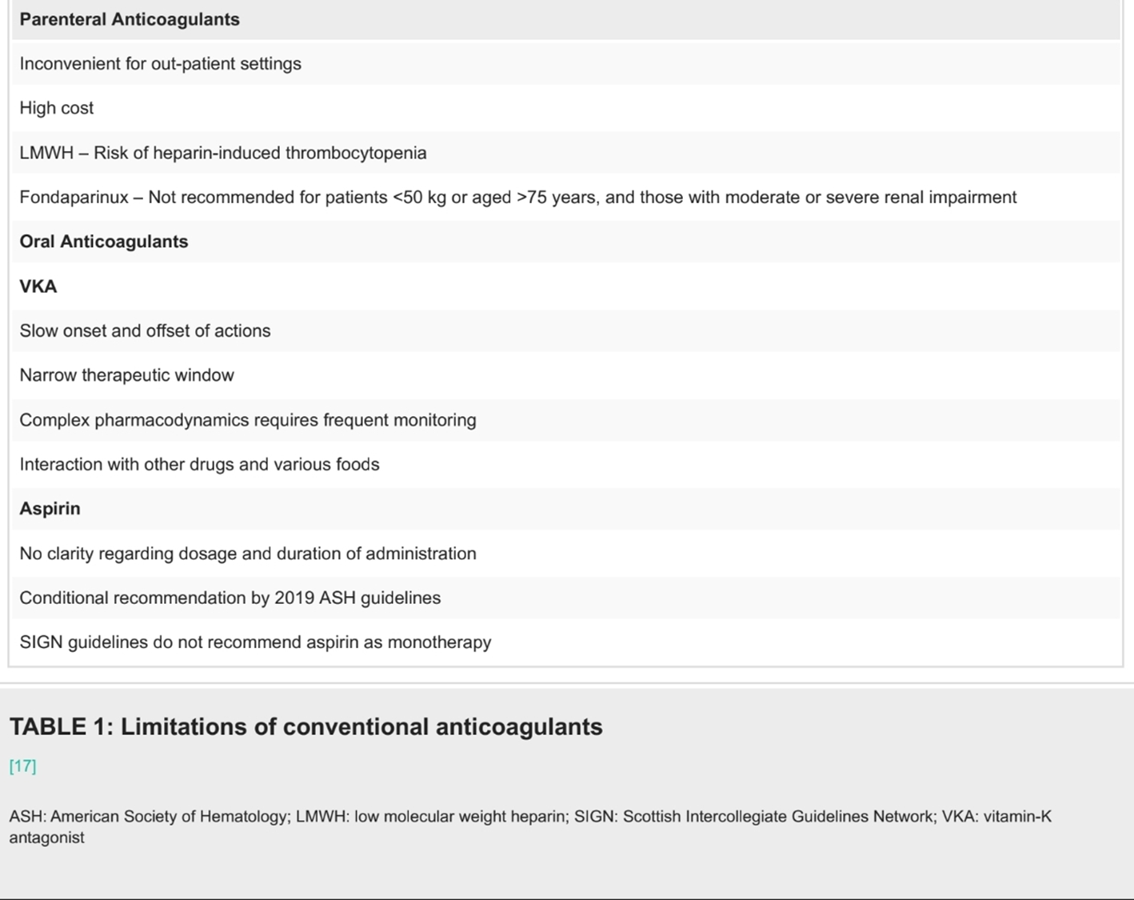
HIT is a condition in which heparin paradoxically cause thrombosis instead of preventing it .
The immune system forms antibodies against a complex of heparin and (PF4), leading to platelet activation and a drop in platelet count (thrombocytopenia).
4-14 days after starting heparin.

Slide 16
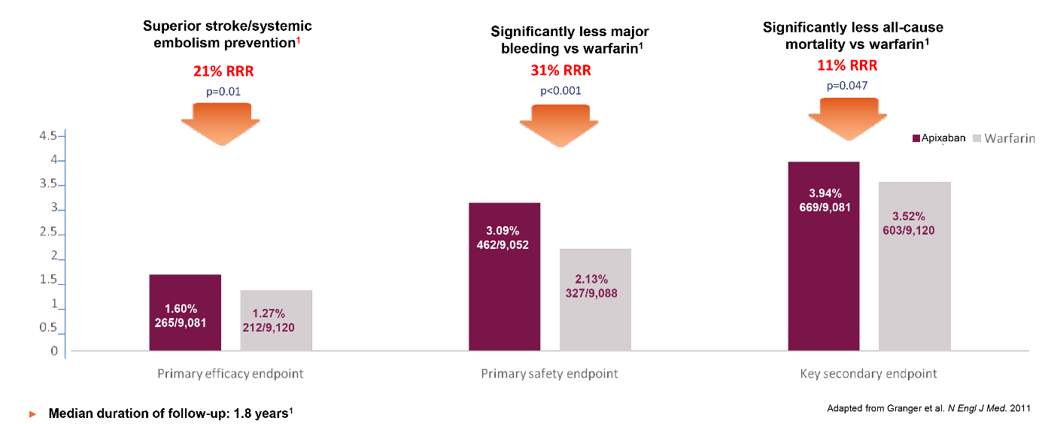
RCT Data: Efficacy and Safety in SPAF
Apixaban demonstrated consistent benefits across NVAF patients with a wide range of stroke risks vs. warfarin.
ARISTOTLE Trial

Slide 17
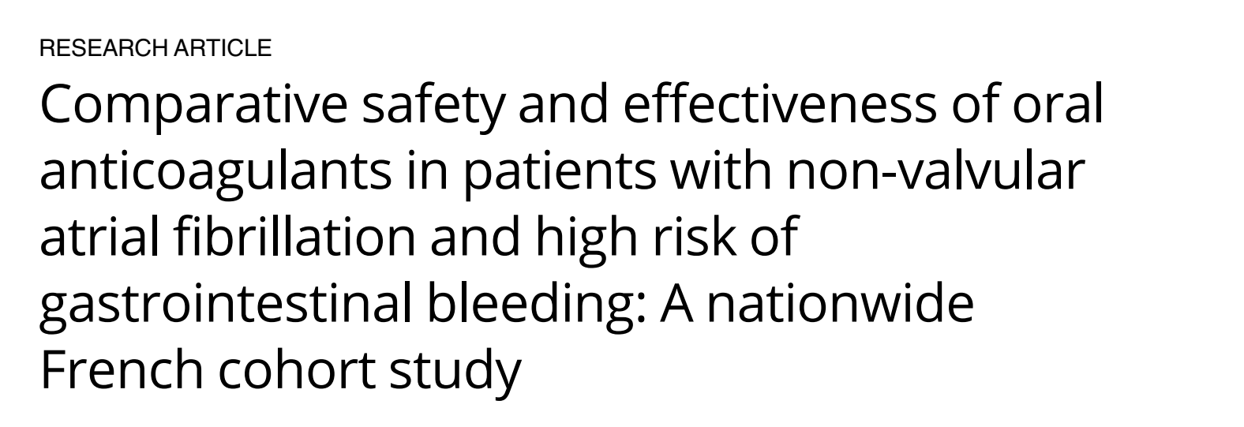
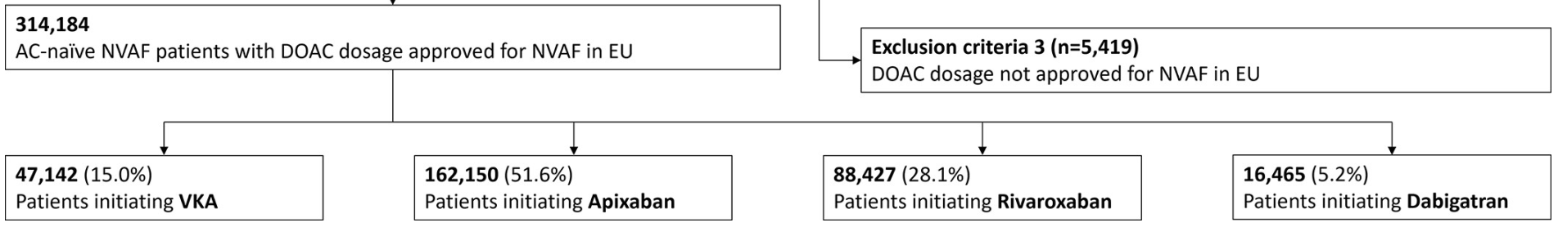
NOAC comparative study
published on November 15, 2024
Apixaban LOWER MB and GIB risk versus other DOACs.
Apixaban LOWER Risk of stroke/SE, versus rivaroxaban.
Notes:
:

Slide 18

Pharmacokinetics Comparison.
Feature | Apixaban ( Afixba ) | Rivaroxaban
Bioavailability | ~50% (not affected by food) | 66% fasting, 80–100% (with food)
Time to Peak (Tmax) | ~3 hours | 2–4 hours
Half-life | ~12 hours | 5–9 hours (up to 13 in elderly)
Protein Binding | ~87% | ~93%
Metabolism | CYP3A4, P-gp | CYP3A4, CYP2J2, P-gp
Excretion | ~25% renal, rest hepatic/fecal | 35% renal , fecal
Dosing Frequency | Twice daily (BID) for all indications | Once daily (QD) or BID depending on phase
Apixaban shows less interpatient variability and more stable plasma levels due to BID dosing, while Rivaroxaban has higher peak-to-trough fluctuations.
Safer for elderly and CKD patients.
Food independent absorption.

Slide 19
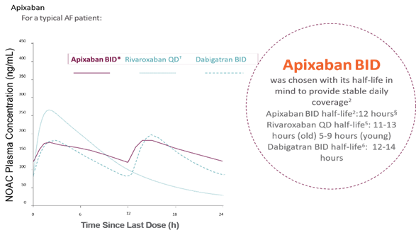
Posology and Method of Administration
Why BID Dosing?
with a half-life of 12 hours, Afixba twice-daily dosing gives your patients stable therapeutic coverage throughout the day which means better predictable anticoagulant effect.

Slide 20
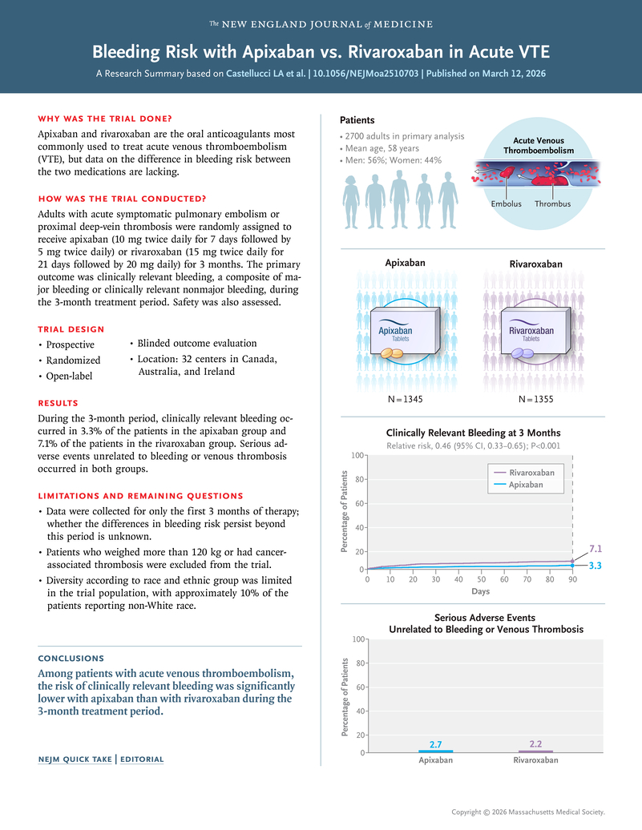
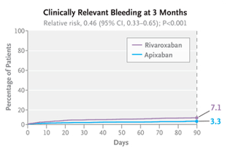
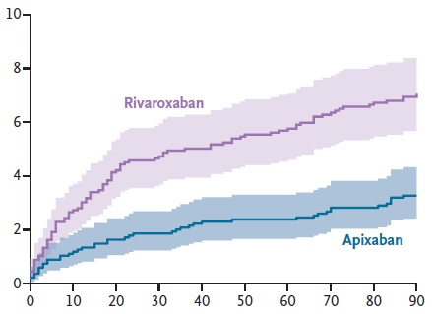
Key Results (Acute VTE):
Bleeding (clinically relevant):
  Apixaban: ~3.3% (~54% lower)
  Rivaroxaban: ~7.1% ( >2× higher)
Major bleeding:
  Apixaban: 0.4% (~84% lower).
  Rivaroxaban: 2.4% (~6× higher).
Recurrent VTE:
  ❗ No significant difference

Slide 21
Pharmacodynamics
Feature | Apixaban ( Afixba ) | Rivaroxaban
Target | Factor Xa | Factor Xa
Anti-Factor Xa Activity | Lower peak to trough Anti FXa Activity, more consistent levels | Higher peak to trough Anti FXa Activity, greater fluctuation
Thrombin Suppression | Sustained and stable | More variable
Monitoring Required | Not routinely | Not routinely
Bleeding Risk | Lower major bleeding risk | higher (esp. GI bleeding)
Apixaban( AFIXIBA) maintained more constant anticoagulation while rivaroxaban had ~3.6x greater
peak-to-trough ratio and higher Anti FXa Activity fluctuation.
Lower major bleeding risk.

Slide 22
Afixba (Apixaban) Perioperative Management
Pre-operation
Check creatinine clearance.
Assess bleeding risk of surgery.
Timing of interruption of Afixba ( Apixaban ) prior to procedures and surgery
Preoperative management | Renal function | Low bleeding risk or minor surgery | High bleeding risk or major surgery
 | CrCl >50 ml/min | Hold 24 hours prior to surgery (skip two doses) | Hold 48 hours prior to surgery (skip four doses)
 | CrCl 30-50 ml/min | Hold 48 hours prior to surgery (skip four doses) | Hold 72 hours prior to surgery (skip six doses)
Bridging anticoagulation during the 24 to 48 hours after stopping Afixba and prior to the intervention is not generally required.
APIXABAN should be restarted after surgical or other procedures as soon as adequate hemostasis has been established.

Slide 23

Afixba (Apixaban) Perioperative Management
Post-operative
Assess bleeding risk of surgery.
Assess haemostatic state of patient and renal function.
Is the patient tolerating oral diet?
Heamostasis achieved
Patient is tolerating oral diet
Patient is not tolerating oral diet
Standard LMWH prophylaxis until be able to take Afixba ( Apixaban)
Post-operative resumption of Afixba ( Apixaban)
Renal function | Low bleeding risk | High bleeding risk
CrCl >50 ml/min CrCl 30-50 ml/min | Resume on day after surgery (12-24 hours) | Resume 2 - 3 days after surgery (48 - 72 hours post-operative)*
For those at high risk of thromboembolism, consider administering a reduced dose of Afixba (Apixaban) on the evening after surgery and on the first post-operative day after surgery or bridging therapy with LMWH/heparin

Slide 24
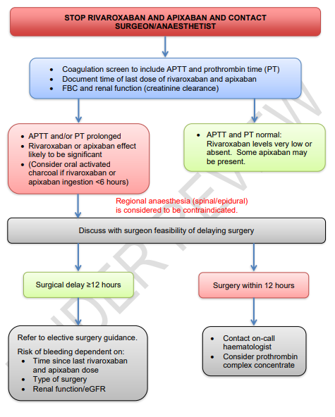

Apixaban Emergency Surgery Protocol
Guideline 240FM.2

Slide 25
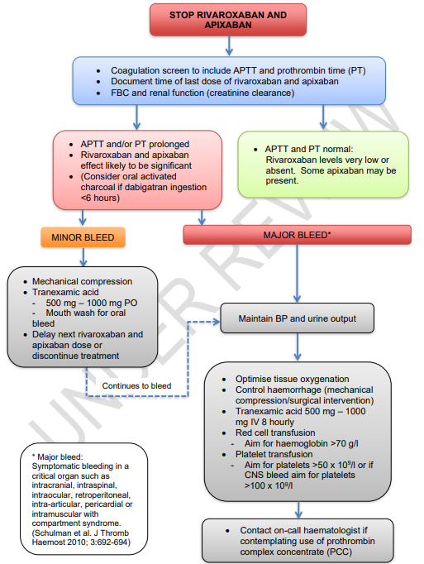

Apixaban Heamorrhage Protocol
Guideline 240FM.2

Slide 26
Major Drug Interactions
Anticoagulants (e.g., warfarin, heparin) | Increased bleeding risk | Use with caution
Antiplatelet Agents (e.g., aspirin, clopidogrel) | Increased bleeding risk | Use with caution
NSAIDs (e.g., ibuprofen, naproxen) | Can impair platelet function and damage GI mucosa | Use with caution
Clarithromycin, Erythromycin | P-gp and strong CYP3A4 inhibition → ↑ plasma level | Use with caution
Antifungal azoles like ketoconazole, Itraconazole | P-gp and strong CYP3A4 inhibition → ↑↑ plasma level | Contraindicated
HIV protease inhibitors like Ritonavir | P-gp and strong CYP3A4 inhibition → ↑↑ plasma level | Contraindicated
Rifampin | P-gp/ BCRP and CYP3A4 induction →↓↓ plasma level | Contraindicated
Carbamazepine, Phenytoin | P-gp/ BCRP and CYP3A4 induction →↓ plasma level | Use with caution

Slide 27

APIXABAN (AFIXBA)
Efficacy and Safety Current Evidence
and Clinical Review

Slide 28
THANK YOU

