Slide 1
Pelvic inflammatory disease (PID)
prepared by Taha Esma’el Ahmed Thebain
Supervision by
Dr/badria Bawazeer Dr/ Hanan Balubid
22/2/2023

Slide 2
Pelvic inflammatory disease (PID)
It is an infection of the upper reproductive tract
organs.
- PID is commonly used to describe acute salpingitis, oophoritis
peritonitis and rarely endmteraitis due to regular mounthly
shedding in childbearing period
- The fallopian tube is the most common organ
affected
- PID is usually caused by bacterialpathogens ascending from
the lower to the upper female genital tract.

Slide 3
Types of PID
A-acute PID :- acute infection ascending from the
cervix, to the tubes and ovaries.
Etology
Neisseria gonorrhea.
Chlamydia trachomatis.
Endogenous bacterio; which may be:
- Aerobic as E.coli, Streptococcus species,bacillus
proteus, and Klebsiella.
- Anoerobic as Bacteroides fragilis, and
Peptostreptococcus.

Slide 4
Routes of infection
1- Ascending infection from endocervicitis by
transluminal spread leading to endosalpingitis.
2- Direct or lymphatic extension from
inflammatory GIT conditions as; appendicitis,colitis, and
diverticulitis
3- Rarely the tubes may be affected by blood borne extension from pulmonary T.B.

Slide 5
Risk factor
Factors associated with increased risk for PlD
- young sexually active woman mostly occurring in the age
group ranging from 25-35 years.
- Women with multiple sexual partners .
- Use of intrauterine contraceptive device (IUCD)
Factors associated with decreased risk for PlD
- Barrier methods for contraception; as the male
condom, the female diaphragm, sponge, and
contraceptive gel-foams, all decrease the risk of
STDs and PlD.
- Oral contraceptive pills (OCPs)

Slide 6
Factor facilitating ascending infection for PlD
- Menstrual periods: due to degenerating
endometrium, retrograde menstruation, and
cervical mucous changes.2/3 of acute PID
cases begin just after menses
- Sexual intercourse: bacteria may be pushed
into the cervix during intercourse
- latrogenic procedures: as D&C operations, IUD
insertion, hysterosalpingography (HSG),hysteroscopy,
and during dye tubal patency testing in laparoscopy.

Slide 7
Pathology of acute salpingo-oophoritis
Infection is usually bilateral, however unilateral
infection is possible.
1. Endosalpingitis; with congestion, oedema, and destruction of tubal luminal cells, cilia, and mucosal folds. lt is either catarrhal
or suppurative
2. Interstitial salpingitis and perisalpingitis; due to extension of infection to the tubal muscularis and serosa. Infection also
spread by direct extension to the tubal ostea and abdominal
cavity.

Slide 8
3. Oophoritis;
may occur with development of micro-abscesses on
ovarian surface
4. Pelvic peritonitis;
may occur either by direct extension from the tubal
lumen laterally, or by lymphatic
spread.
5. Chronic PID; see later

Slide 9
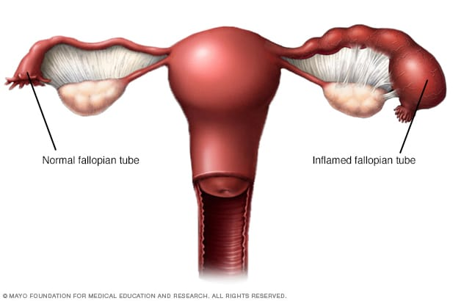
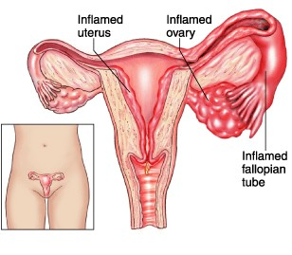

Slide 10

Clinecal pictuer
Symptoms:
- Acute lower abdominal pain is the
most common symptom
- Fever, headache, and malaise
- GIT symptoms; as nausea and vomiting.
- Increased vaginal discharge, and
sometimes vaginal bleeding.

Slide 11
Diagositic investigation
1. Examination of Cervico-vaginal discharge:
- Gram stain: is useful in diagnosis of N. gonorrhoea
- Testing for Chlomydial and gonorrheal antibodies;
2. Blood tests:
- lncreosed WBCs (Leucocytosis)
- lncreased ESR
3. Ultrasound:
- Findings may be normal or non-specific.
- TVS to exclude ectopic pregnancy, uterine myomata,
and ovarian swellings.

Slide 12
4. Laparoscopy:
- Laparoscopy is considered the gold standard to confirm the
diagnosis whenever in doubt or in cases with poor response to parentral antibiotic therapy after 48-72 hours of initiating
treatment.
5. Culdocentesis:
- Aspiration of purulent fluid in the pouch of Douglas may assist diagnosis and antibiotic selection after culture and sensitivity, yet its use is limited by its associated pain, and tendency
for secondary infection.
6. Testing for HIV and STDs:
should be offered to all women diagnosed as PlD.

Slide 13
            Differential diagonsis for PID
1. Ectopic pregnancv
2. Torsion or ruptured ovarian cyst
3. Degenerating fibroids
4. Endometriosis and ovarian endometriomas.
5. Inflammatory bowel disease; as appendicitis
and diverticulitis

Slide 14
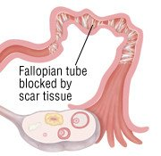
Complication of PID
1. Tubal obstruction and infertility
2. Ectopic pregnancy
3. Chronic pelvic pain
4. Mortality

Slide 15
            Treatment of acute PID
            Rest in bed
Analgesics and antipyretics
Antibiotic treatment

Slide 16
            Treatment of Tubo-Ovarian Abscess (TOA)
A. Medical:
- Clindamycin 900mg lV/8 hours + Metronidazole 500 mg lV/8
hours + Doxycycline 100mg orally/12 hours (triple therapy).
B. Surgical: Considered in severe cases whenever the
patient's condition worsens or does not improve within
72 hours of treatment, or whenever diagnosis is not
definitive.
- Laparoscopy:
Diagnostic loporoscopy confirms diagnosis whenever in doubt
Operotive laporoscopy may assist drainage or for performing unilateral salpingooophorectomy.

Slide 17
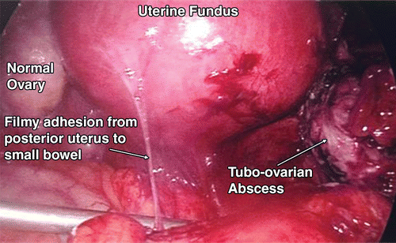
- Laparotomy:
To perform drainage, or salpingo-oophorectomy.
- Vaginal drainage :
rarely done is selected cases of localized TOA.

Slide 18
B- Chronic PID:- chronic pelvic infection that can follow an acute episode of PlD, or may occur as asequel to an inflammatory pelvic lesion or genital T.B.
            Aetiology
1. complication of acute PID (inadequate treatment or
neglected cases)
2. TB starts as chronic disease (however it is better to
be a separate entity).

Slide 19
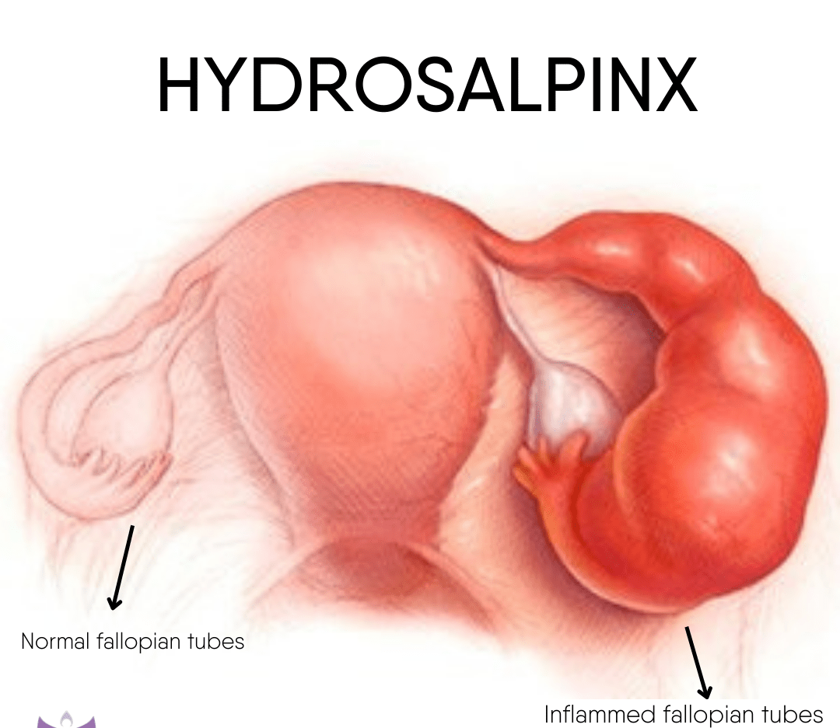
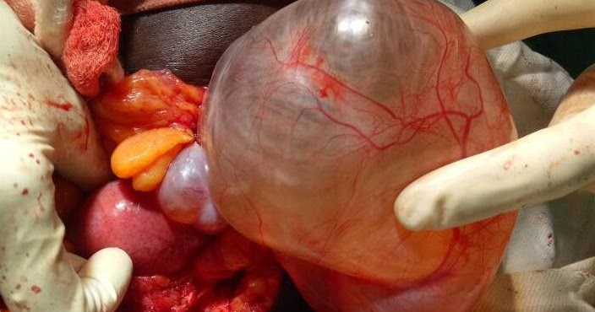
            pathology
Hydrosalpinx: sequelae of acute catarrhal salpingitis.
The tube is retort shaped,thin walled,transparent, containing serous fluid, with no or minimal surrounding adhesions.

Slide 20
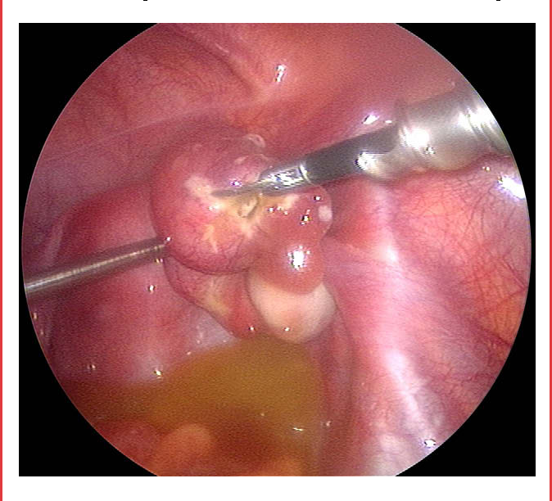
2. Pyosalpinx: sequelae of
acute suppurative salpingitis.
The tube is thick walled,
containing pus,and surrounded
by dense adhesions.
3. Chronic interstitial salpingitis.
4. Tubo-ovarian cyst: communicating between hydrosalpinx
and ovarian cyst
5. Tubo-ovarian abscess: connecting between pyosalpinx and
ovarian abscess

Slide 21
            Clinical pictuer
A. Symptoms
- History of acute PID
- Dull aching lower abdominal pain
- Lower Backache; especially sacral
- Pelvic congestive symptoms; as vaginal discharge, and
menorrhagia
- Secondary dysmenorrhoea: due to pelvic congestion and/or
tuba-ovarian mass
- Chronic pelvic pain
- Infertility (primary or secondary) due to tubo-peritoneal
factor whether associated with dense adhesions or tubal
occlusion.
B. Signs: Adnexal swelling; usually bilateral, tense cystic,
tender, fixed, with fixed RVF

Slide 22
            Diagnostic investigation
- Pelvic ultrasonography (TAS I TVS): to detect adnexal
masses
- Diagnostic Laparoscopy: to confirm the nature of adnexal
mass
- For TB
            Differential diagnosis :
- Pelvic endometriosis, or pelvic malignancy.
- Other non gynaecologic causes of chronic pelvic pain

Slide 23
            Treatment of chronic PID
- Antibiotics are used only in acute exacerbations or
when bacterial existence is diagnosed.
- Symptomatic treatment for pain (analgesic), inflammation
(NSAID) and congestion (anticongestives).
- Infertile patients; are best advised for lCSl/ lVF procedures
since tubal surgery (salpingolysis or salpingostomy) have
poor prognosis.
- Elderly patients and cases resistant to medical treatment
that have completed their family may benefit from surgery
with total abdominal hysterectomy and bilateral
salpingooophorectomy(TAH-BSO).

Slide 24
Thank you

